Slide 1


Alaska ACE: Adapting to Changing Environments

Slide 2
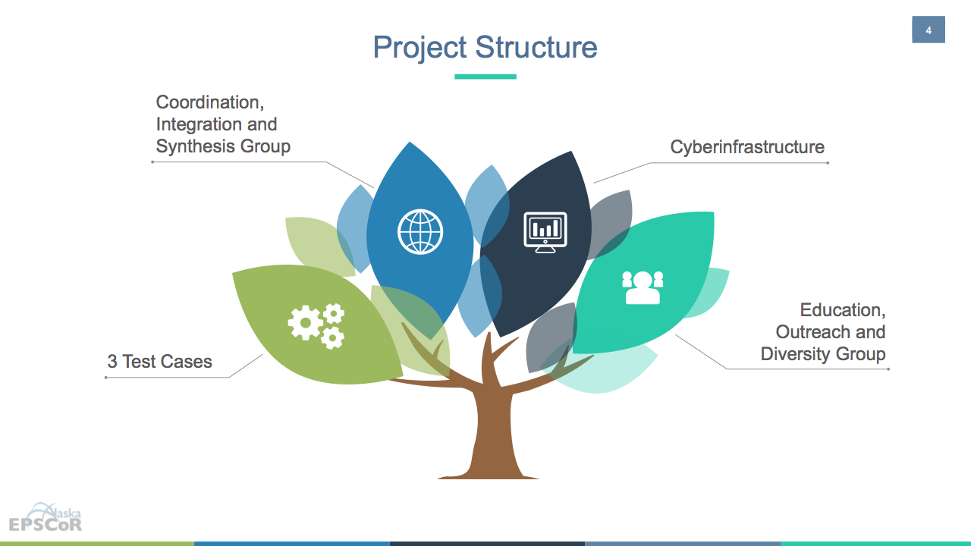
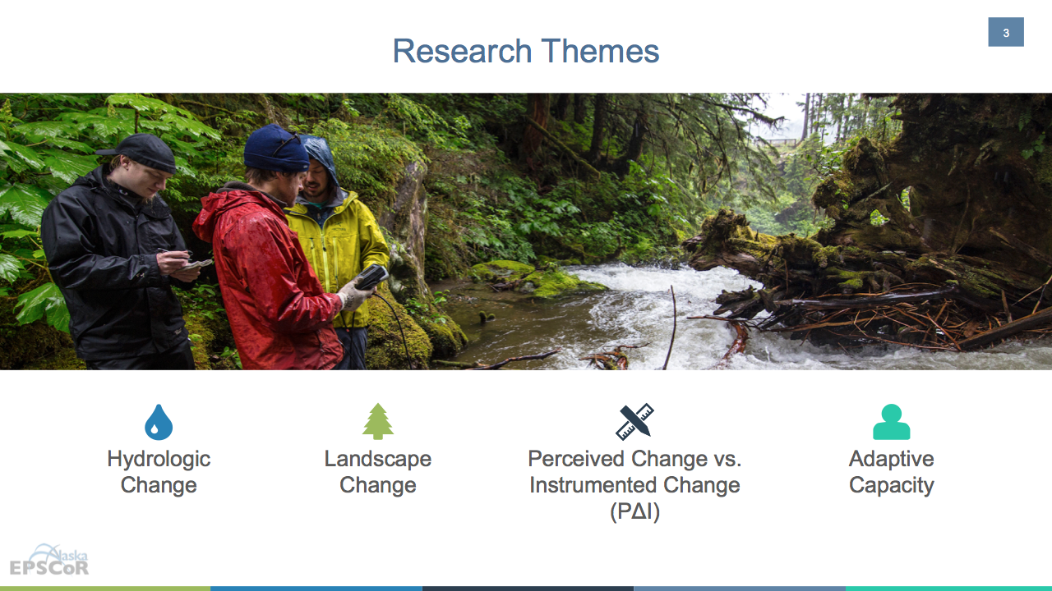

Slide 3
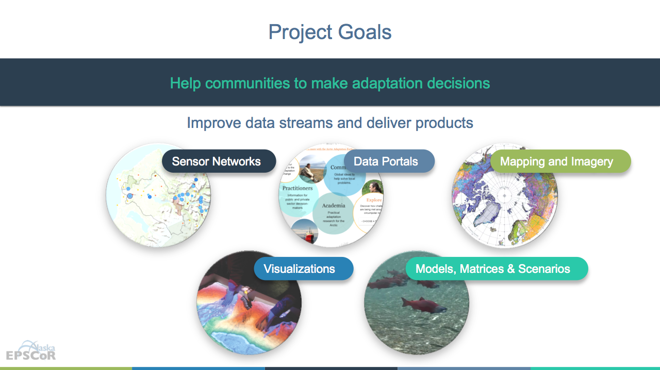
Benefits of Large High Resolution Display Environments - (Jason Leigh of U. of Hawaii)
Reducing window switching, see detail & context simultaneously [Czerwinksi03, Ball05]
Helps externalize the working memory of teams [Andrews10]
Increases parallel processing amongst team members [Park03]
Improves location memory of information [Tan01]
Perceptual scalability: helps user performance keep pace with increasing data size [Yost07]
Results in greater confidence in conclusions drawn when able to see all info at once [Ball05]
Users begin to look for higher level patterns & relationships (i.e. they start to look for the bigger picture) [Reda12]
Notes:
Reduces gender performance gap in navigation tasks in VR [Tan03]

Slide 4
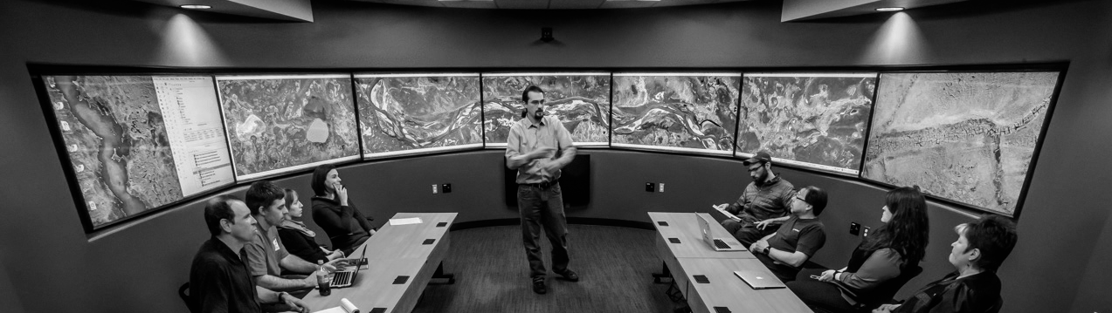
Decision Theater North is a gathering place for people to discuss issues that span the boundaries of location, time, and discipline.

Slide 5

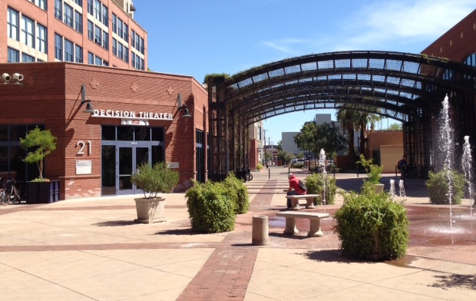
Decision Theater Network
ASU Decision Theater
Arizona State University
Tempe, AZ
ASU Decision Theater
McCain Institute
Washington, D.C.

Slide 6

Data to Decisions
People
desirability
Data
reliability
Solutions
sustainability

Slide 7

The mission of Decision Theater North is to provide a cutting-edge, immersive, visual environment to facilitate dialogue and decision-making by agencies, industry, communities and academia.

Slide 9
The mission of Decision Theater North is to provide a cutting-edge, immersive, visual environment to facilitate dialogue and decision-making by agencies, industry, communities and academia.

Slide 10
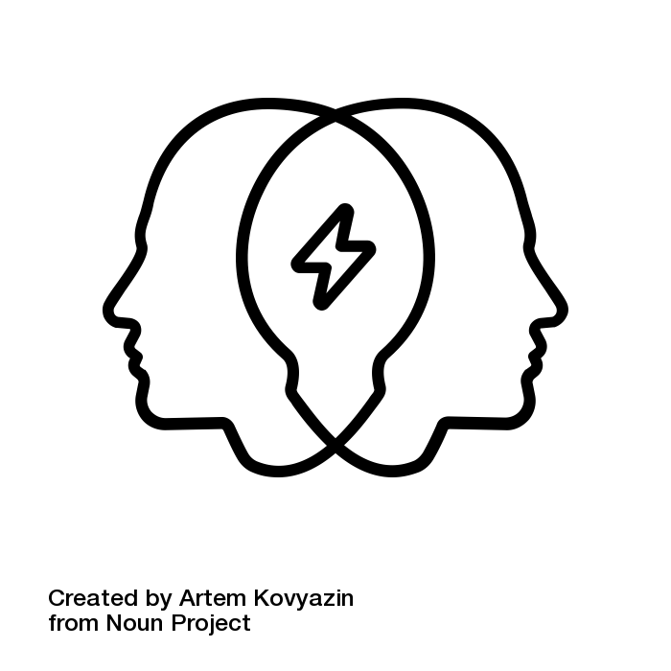

Large Screen Displays Support People and Teams
Shared knowledge
Cognition as a team
Computer-supported cooperative work
Distributed situational awareness
Complex collaborative environments
How does cognition operate when tackling complex issues?
How do mental models inform how a team functions?
How does memory influence teams?
How can we improve team effectiveness?

Slide 11





Large Screen Displays Turn Data into Decisions
Knowledge to Decisions
Information and Visualizations
Data

Slide 12
Powerful & Accessible

Slide 13
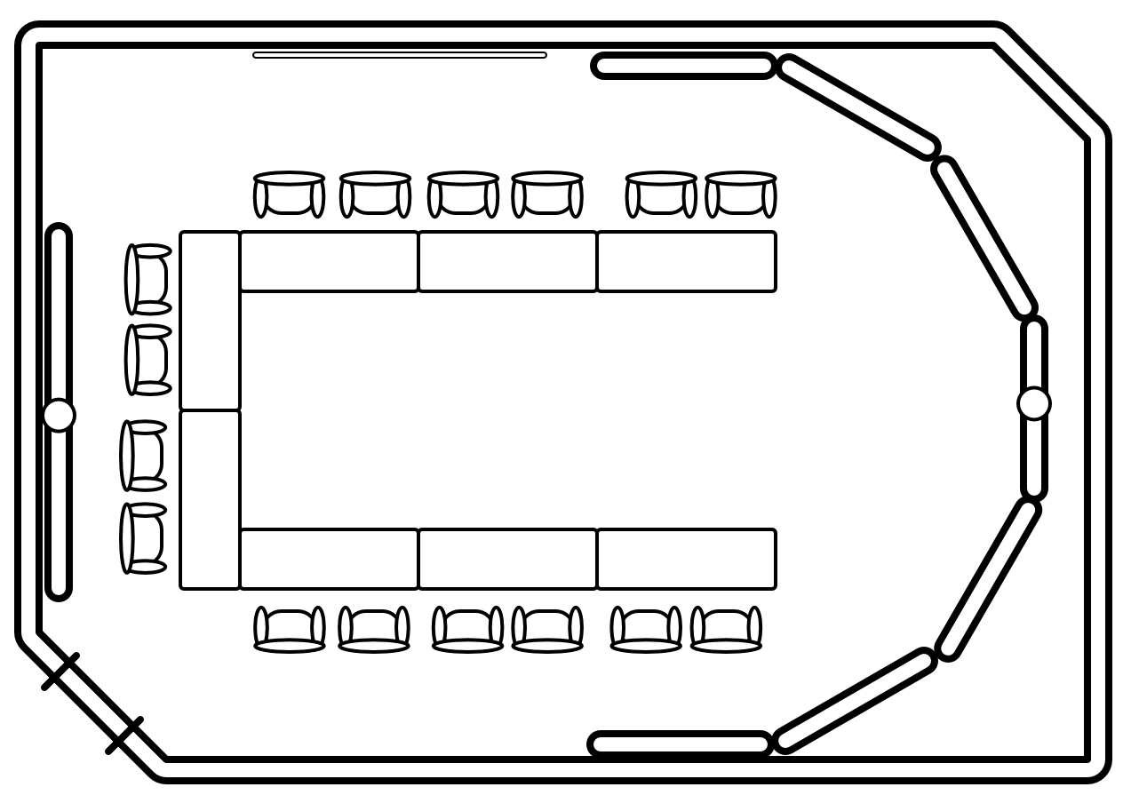
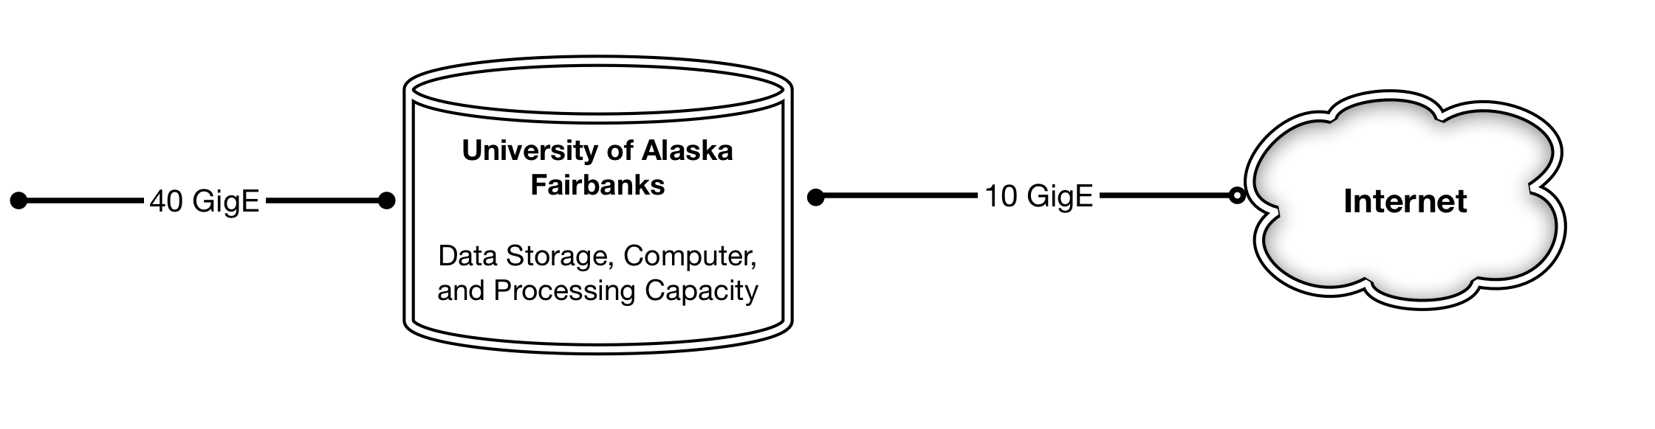
Technology & Network
Seven 4k screens
+ video conferencing
Compute power + access to data
Optimized network + internet connectivity

Slide 14






Decision Theater North Software
Microsoft Windows
GIS and Mapping tools
Data analysis capabilities

Slide 15
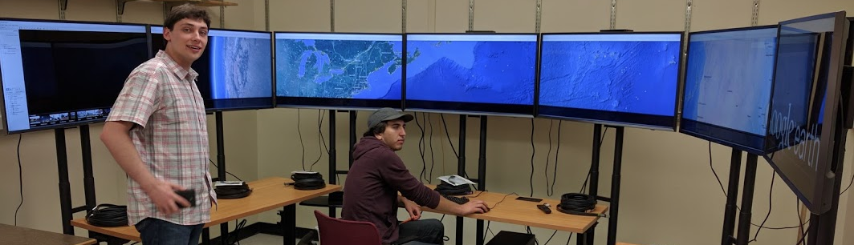
Decision Theater North: Development Space
Testing and learning space for technology and content creation

Slide 17
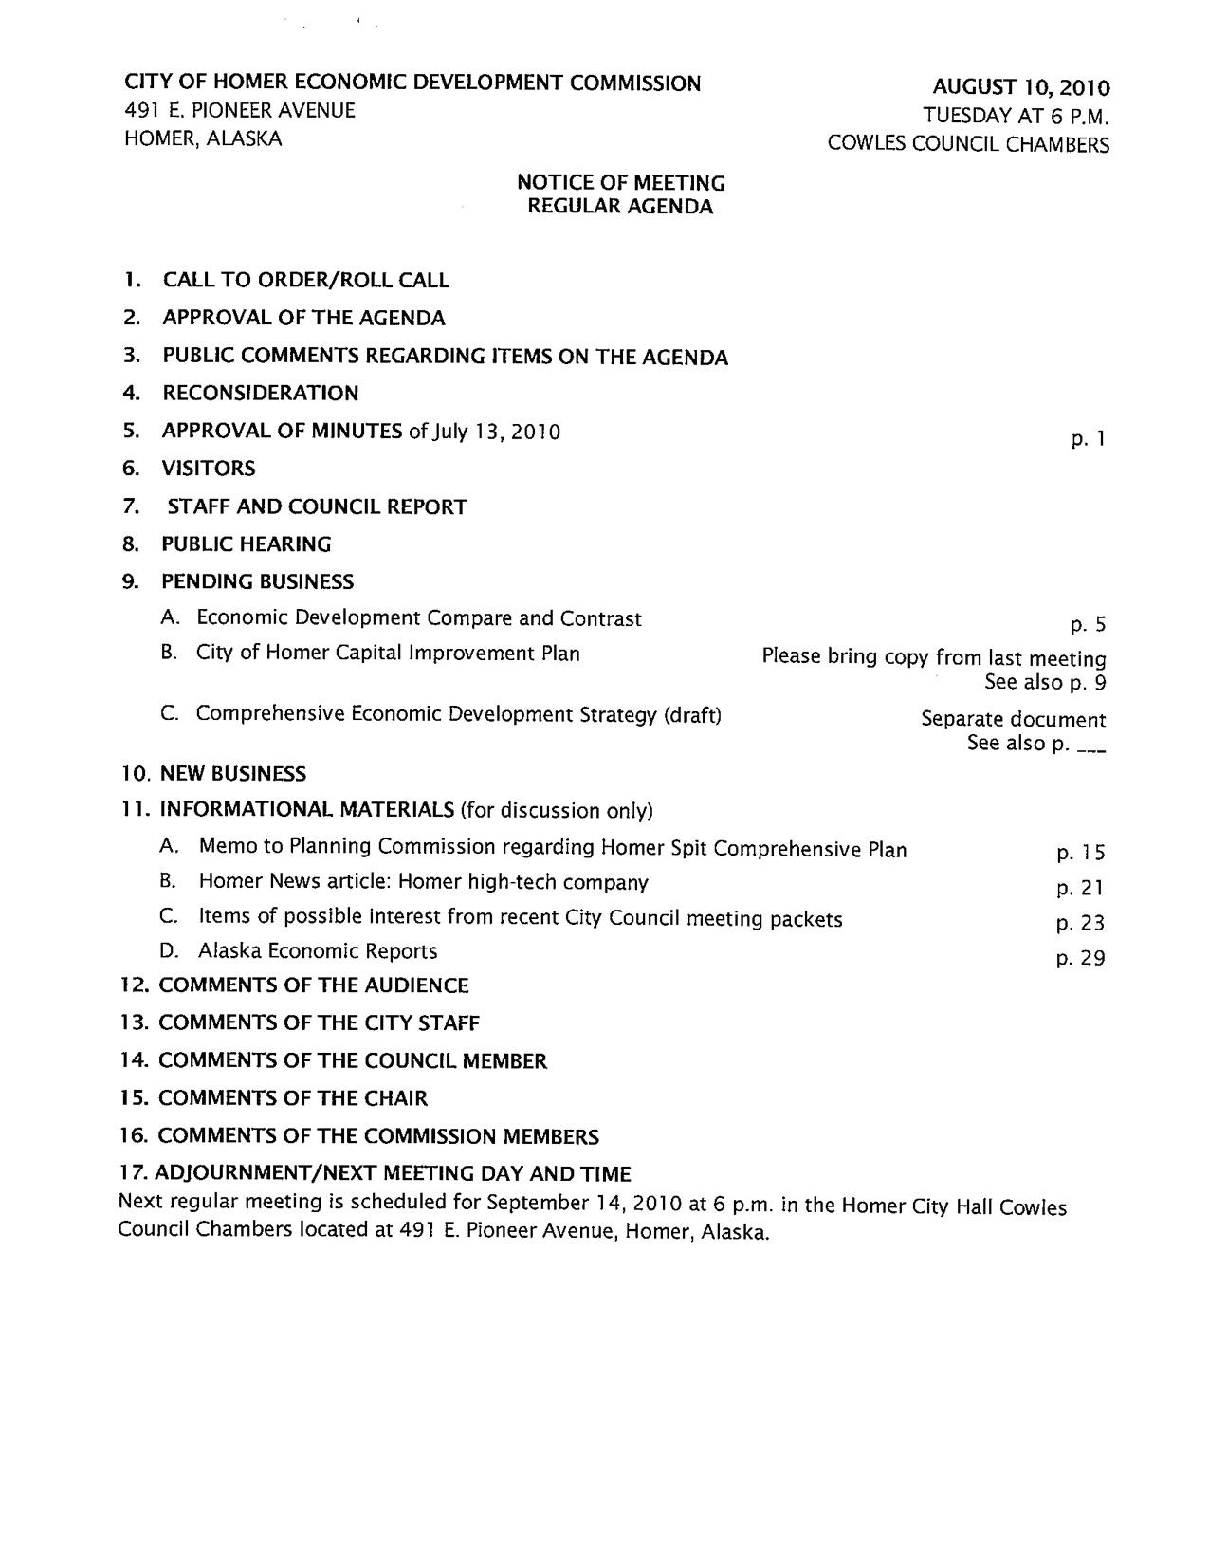

Use Case: Strategic Planning
Agenda

Slide 18
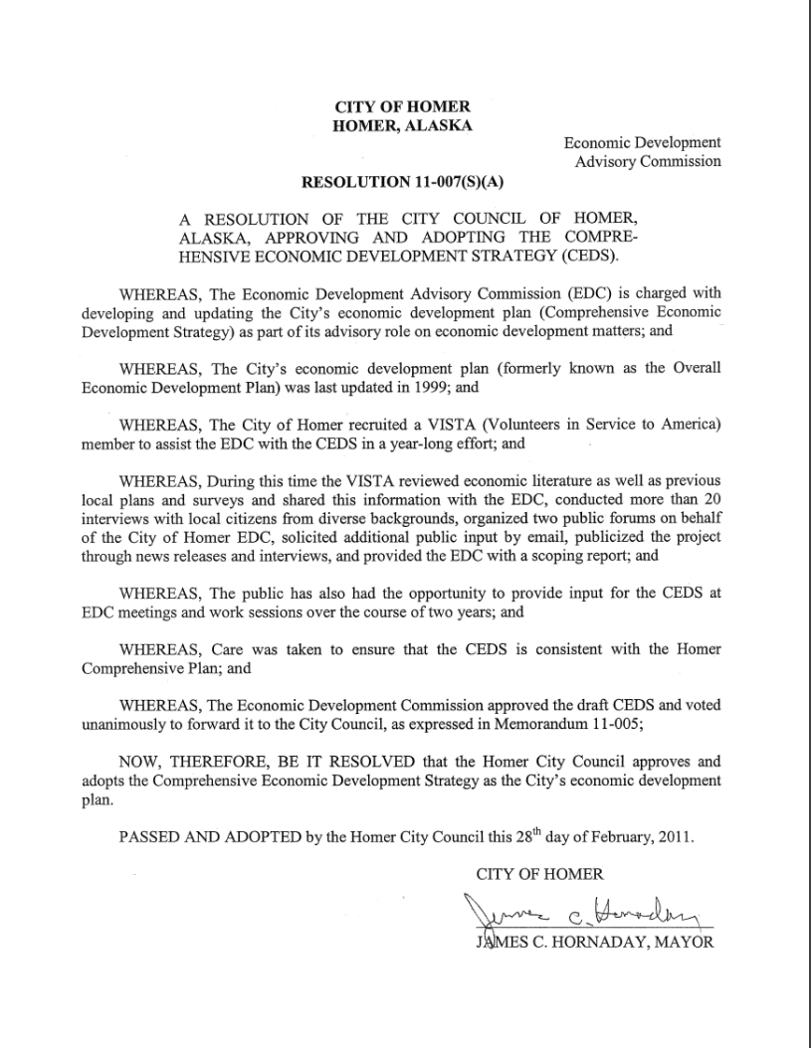

Use Case: Strategic Planning
Legislation

Slide 19
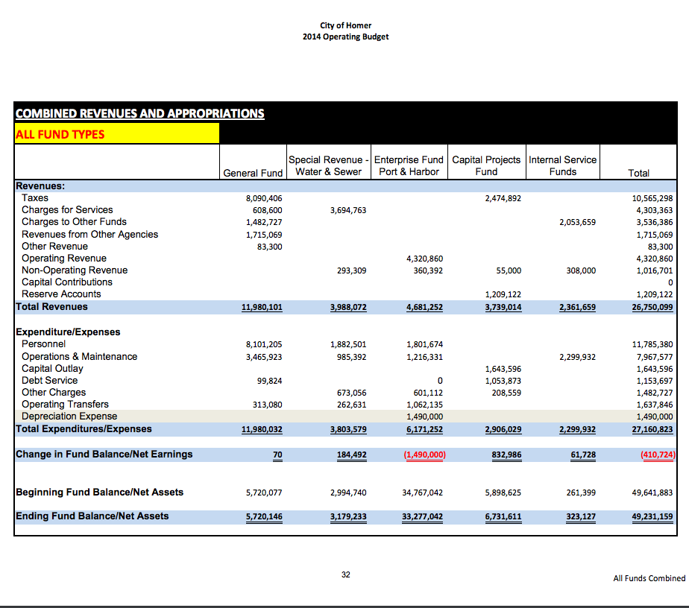

Use Case: Strategic Planning
Budget
link

Slide 20
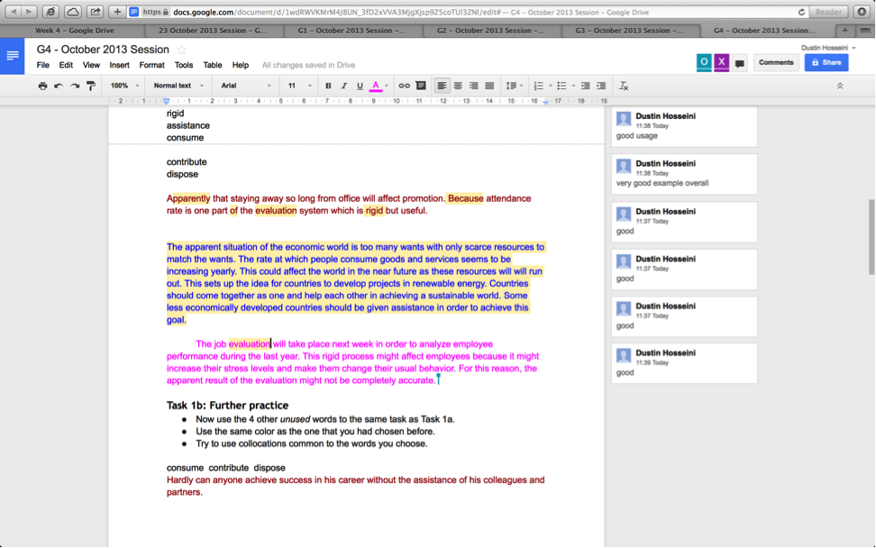

Use Case: Strategic Planning
Collaborative Document Development

Slide 21
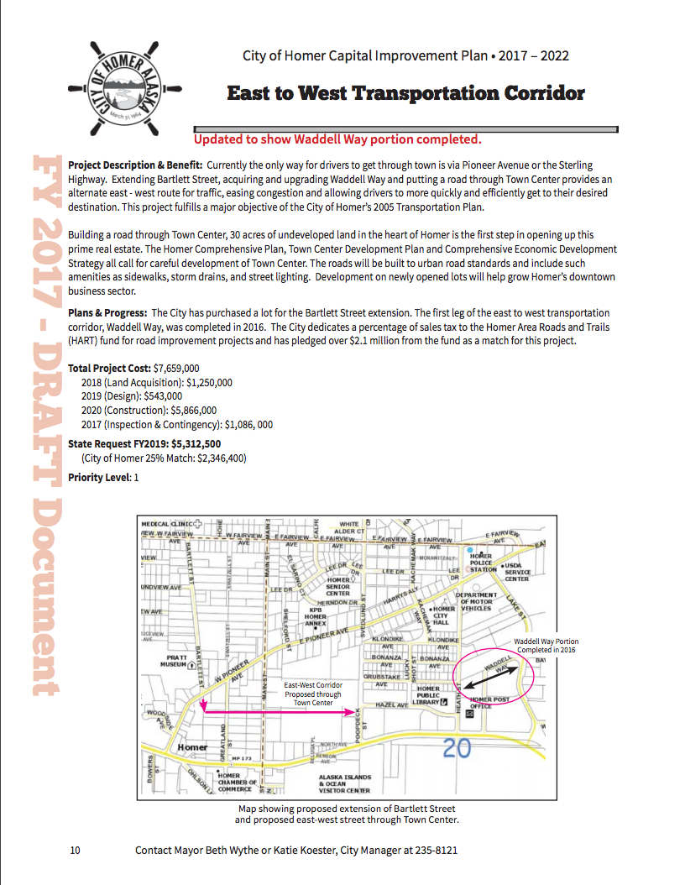
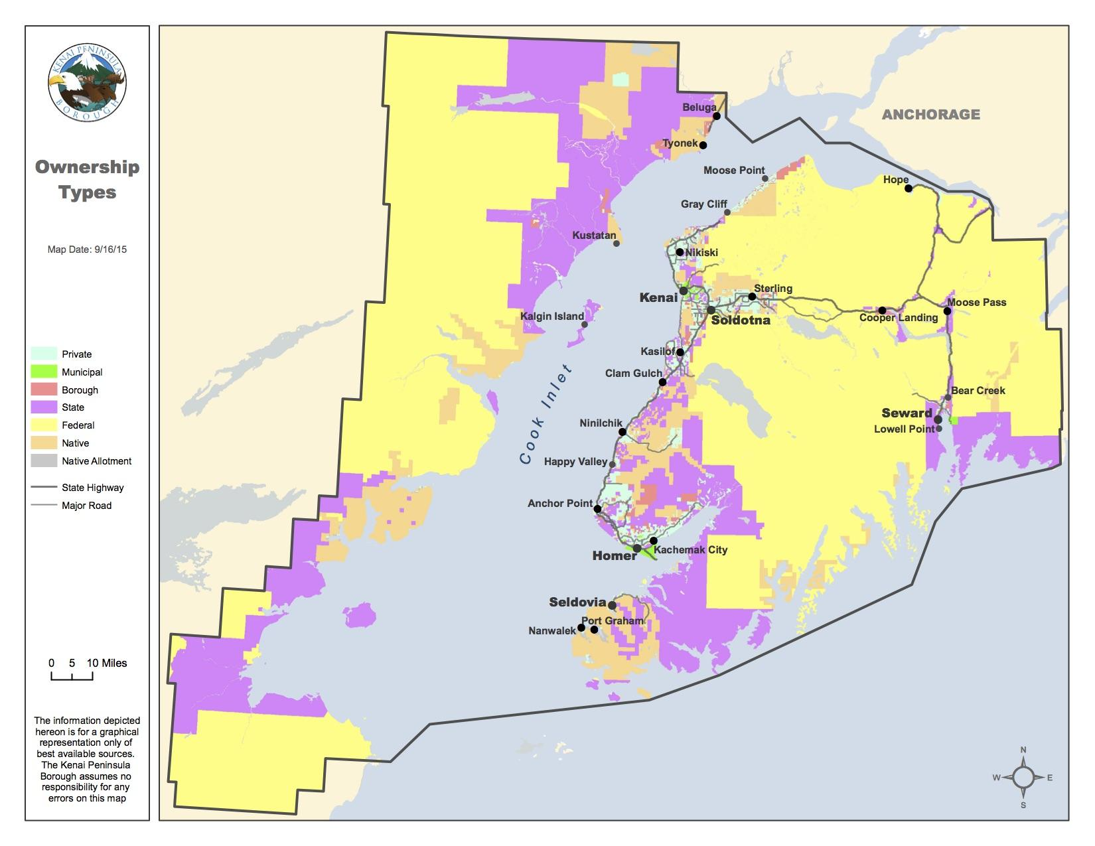

Use Case: Strategic Planning
Map

Slide 22
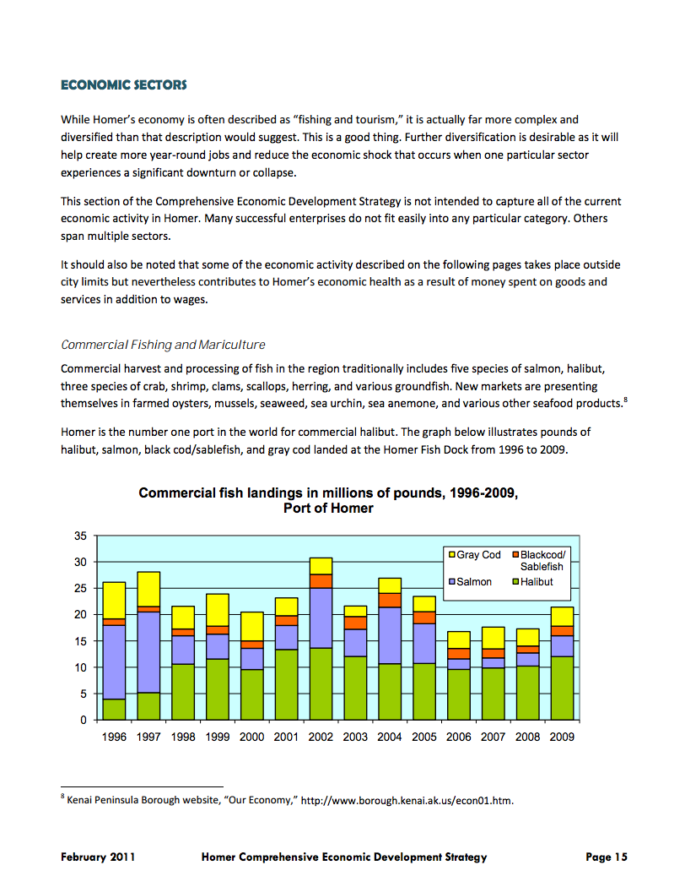

Use Case: Strategic Planning
Supporting
Documentation

Slide 23
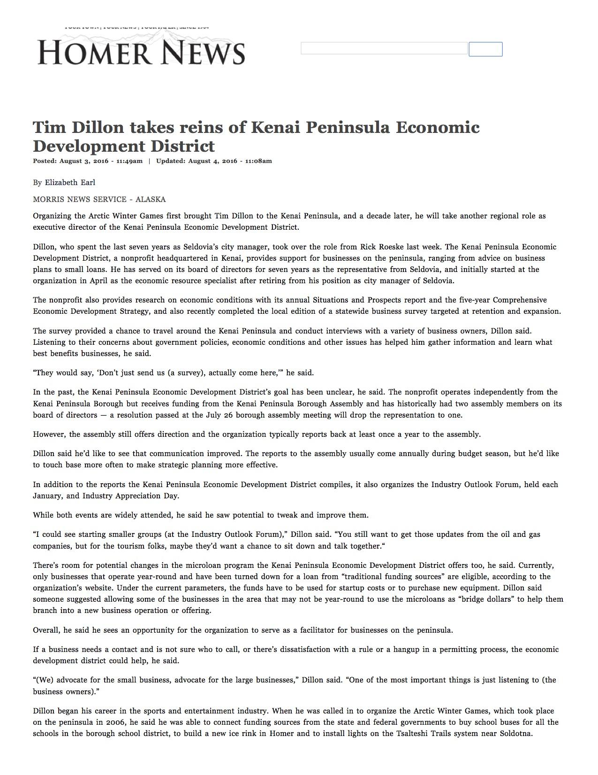

Use Case: Strategic Planning
News Article

Slide 25
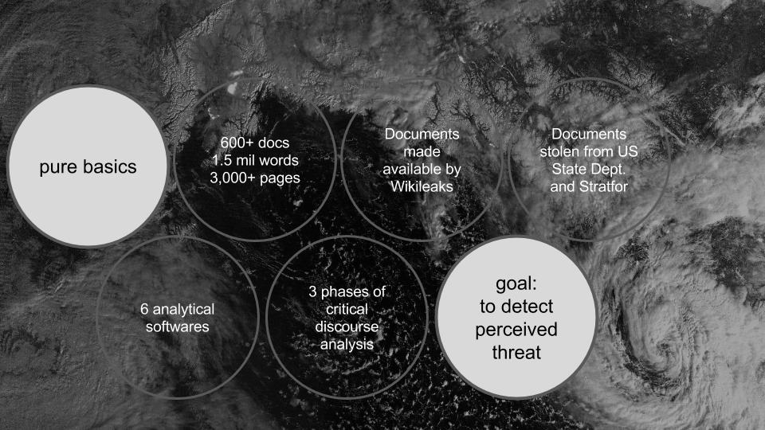

Use Case: Presentation
Context

Slide 26
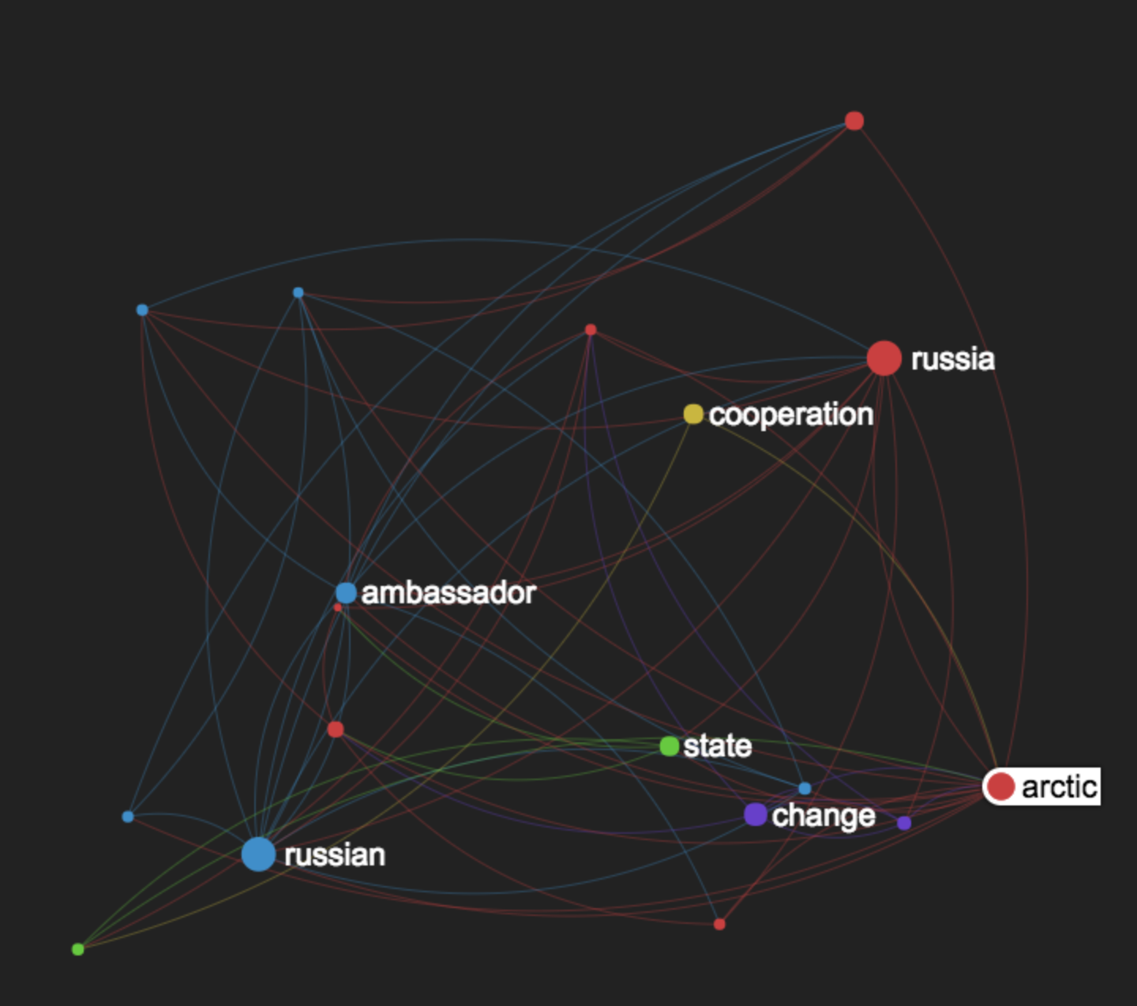

Use Case: Presentation
Data Visualizations

Slide 27
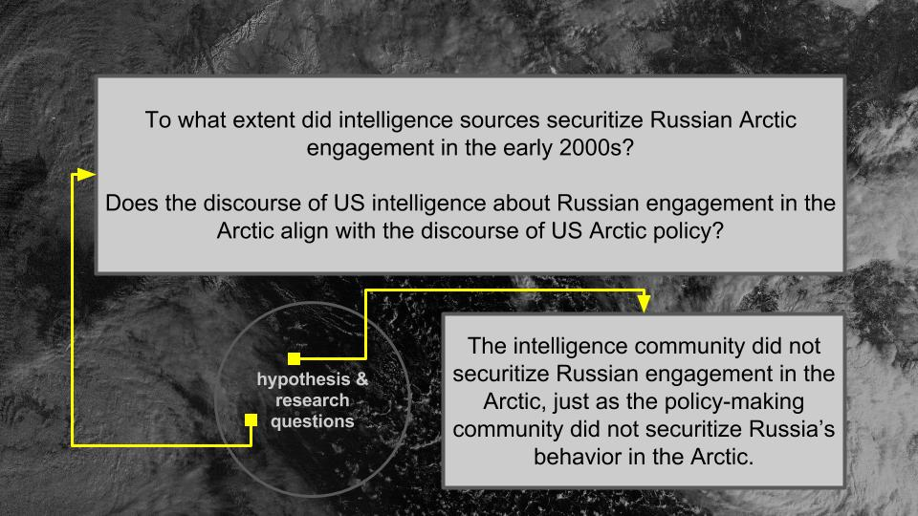
Use Case: Presentation
Context

Slide 28
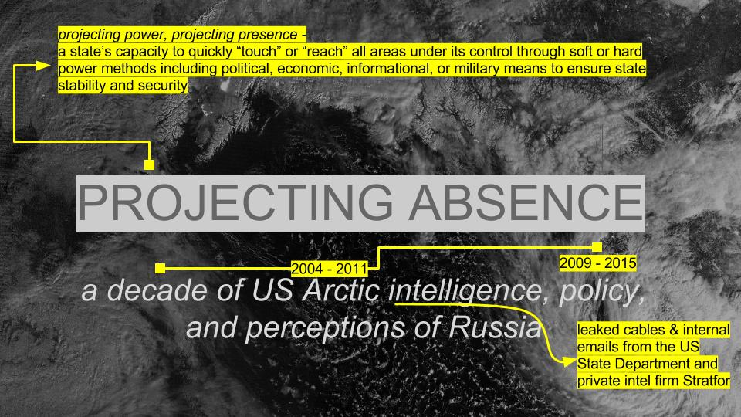
Use Case: Presentation
Title

Slide 29
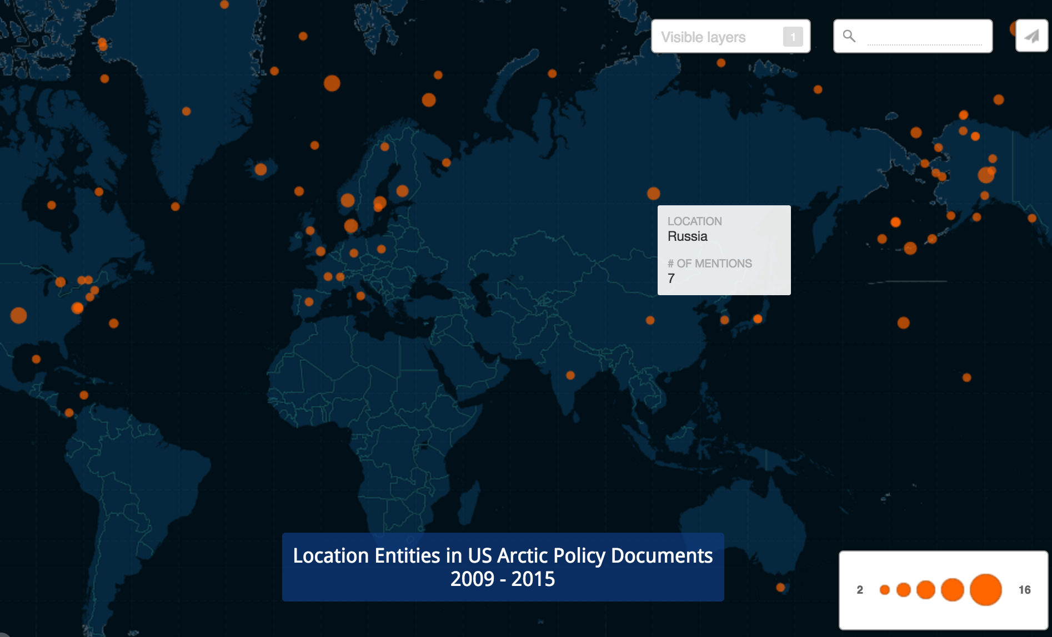

Use Case: Presentation
Data Visualization

Slide 30
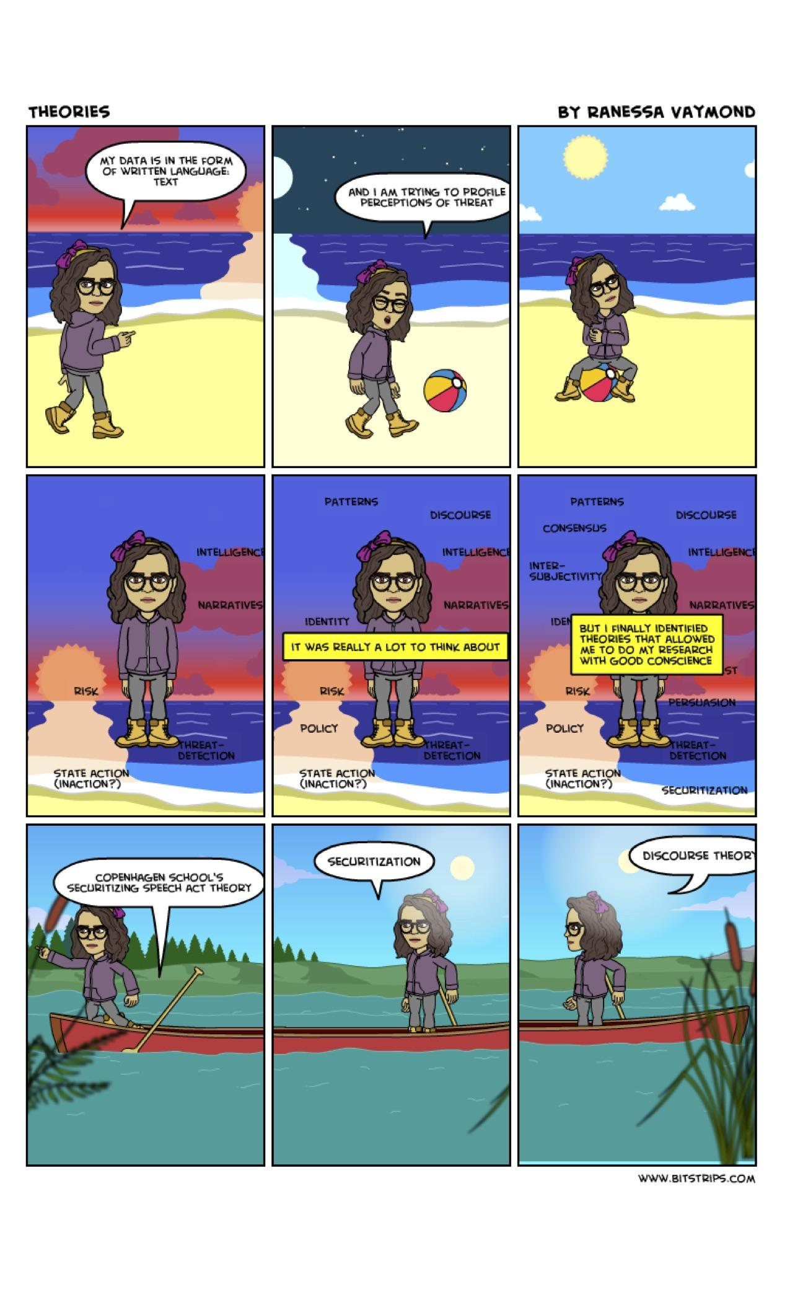
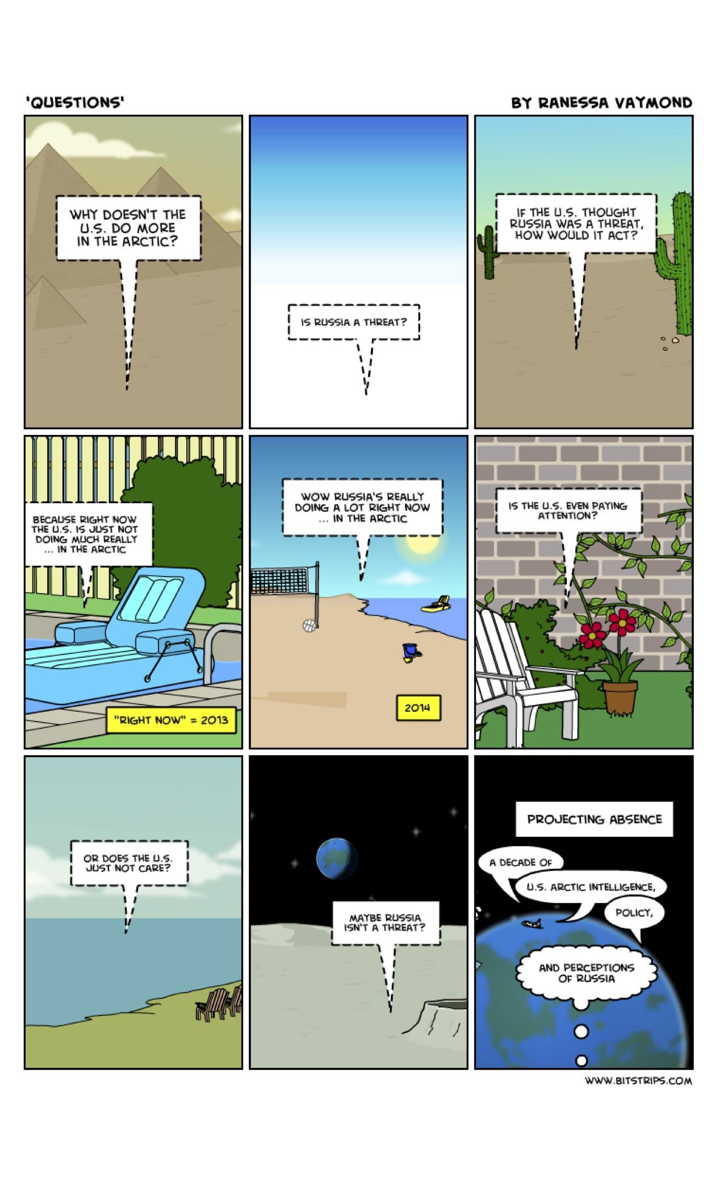
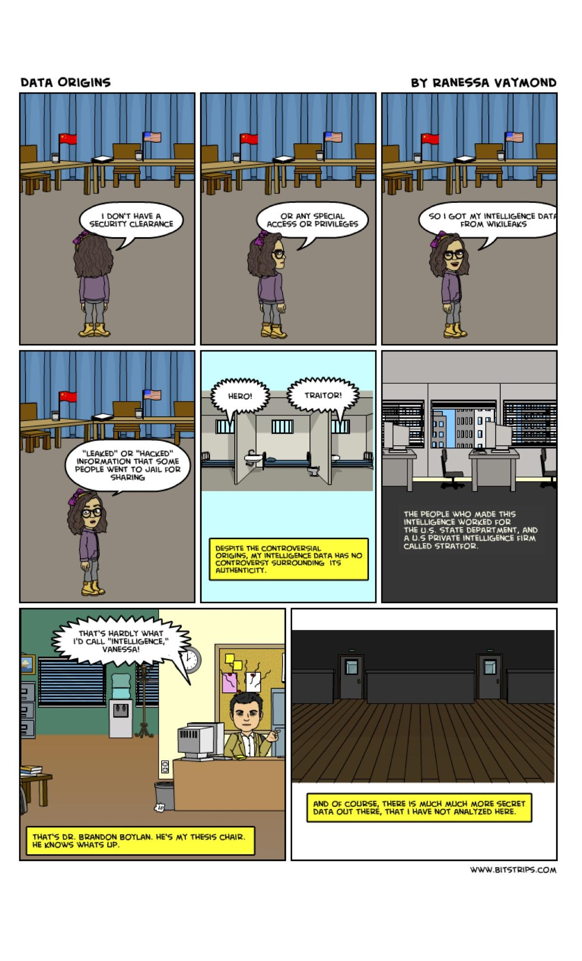
Use Case: Presentation
Visualizations

Slide 31
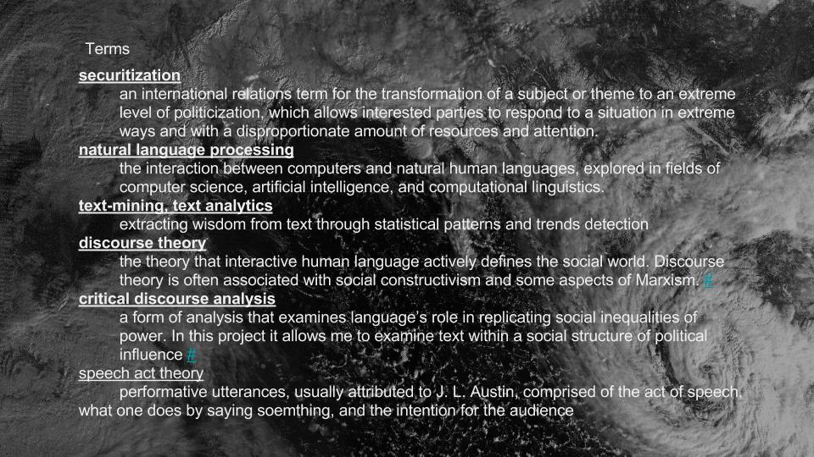
Use Case: Presentation
Context

Slide 33
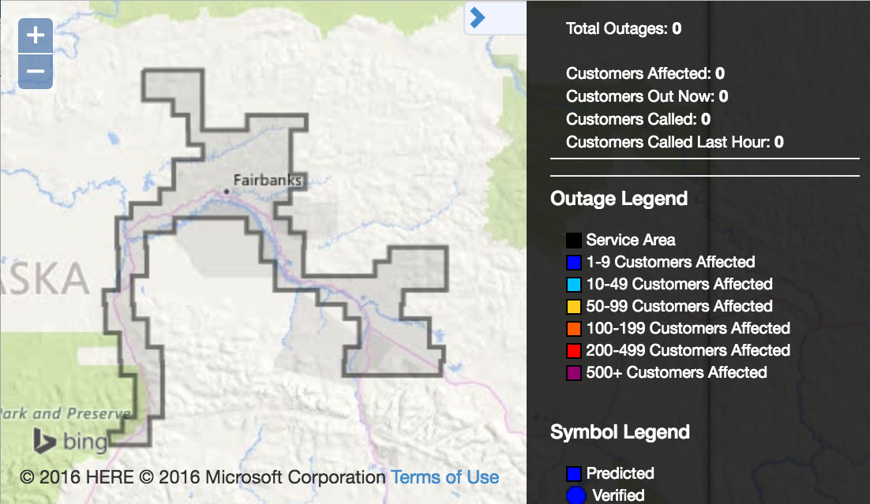
Use Case: Emergency Management
Map

Slide 34
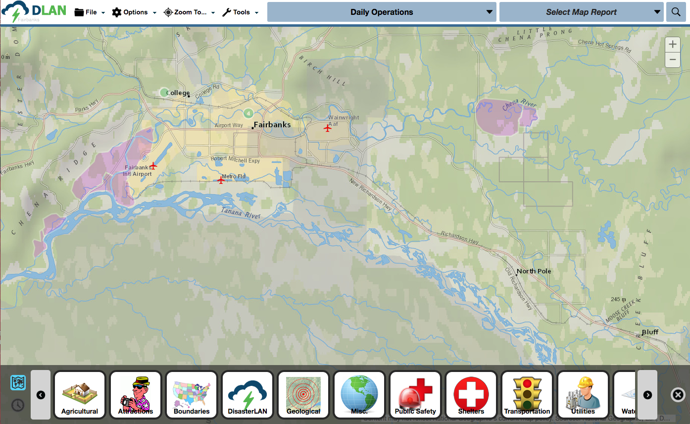
Use Case: Emergency Management
Common Operating Picture

Slide 35
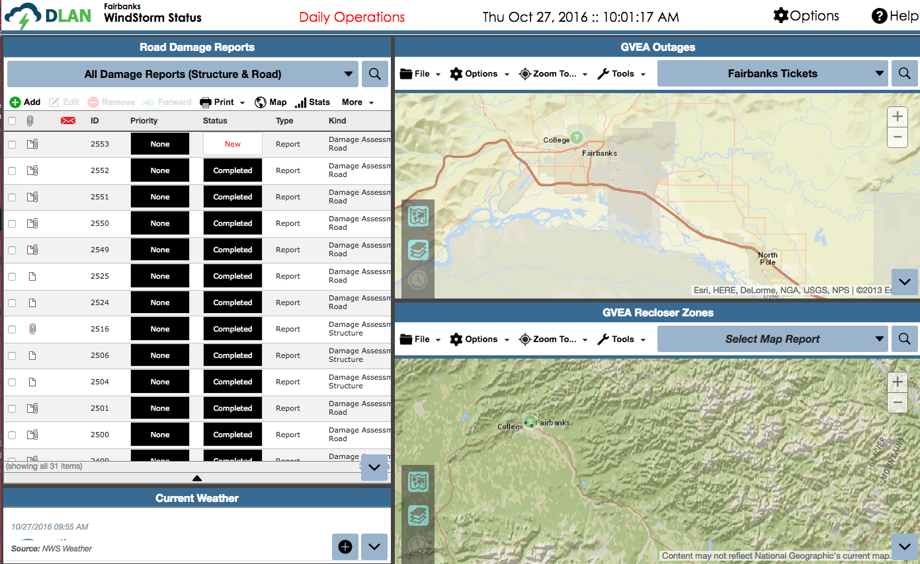
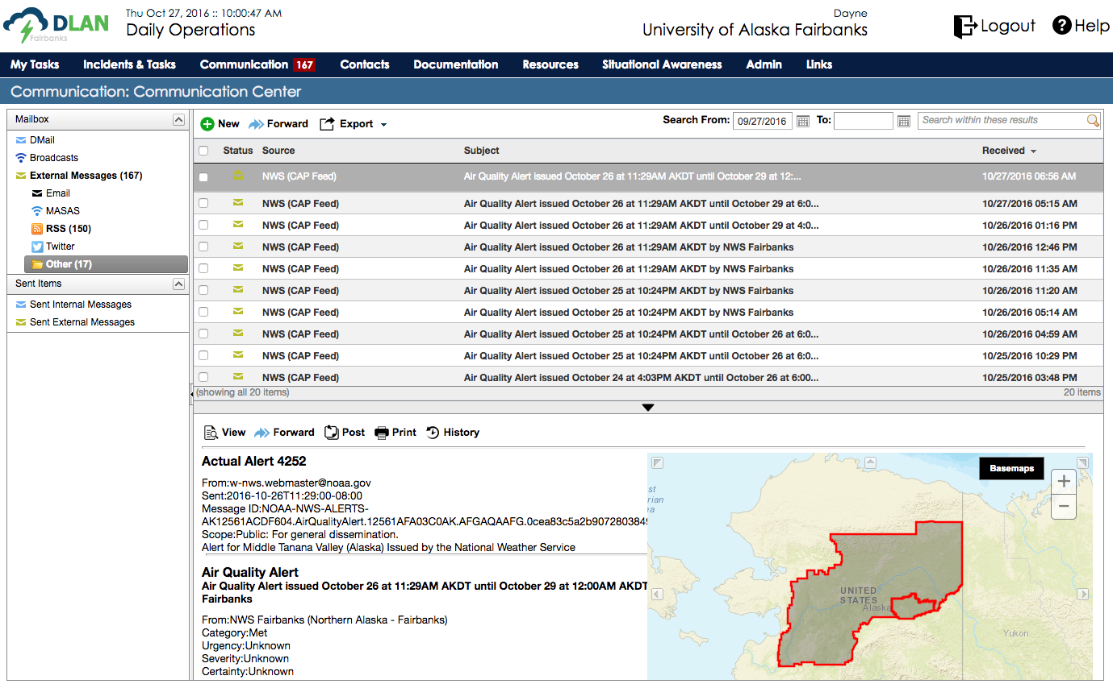
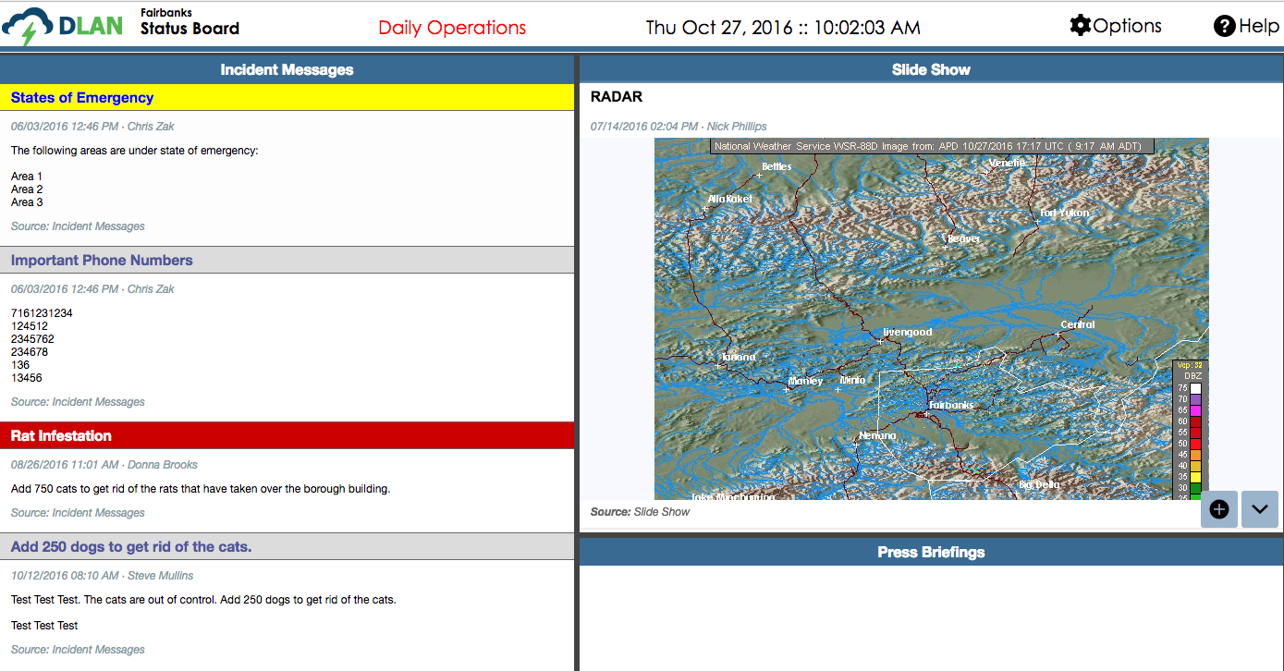
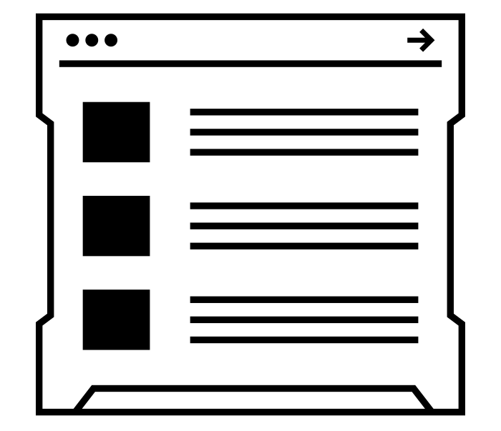
Use Case: Emergency Management
Daily Operations

Slide 36
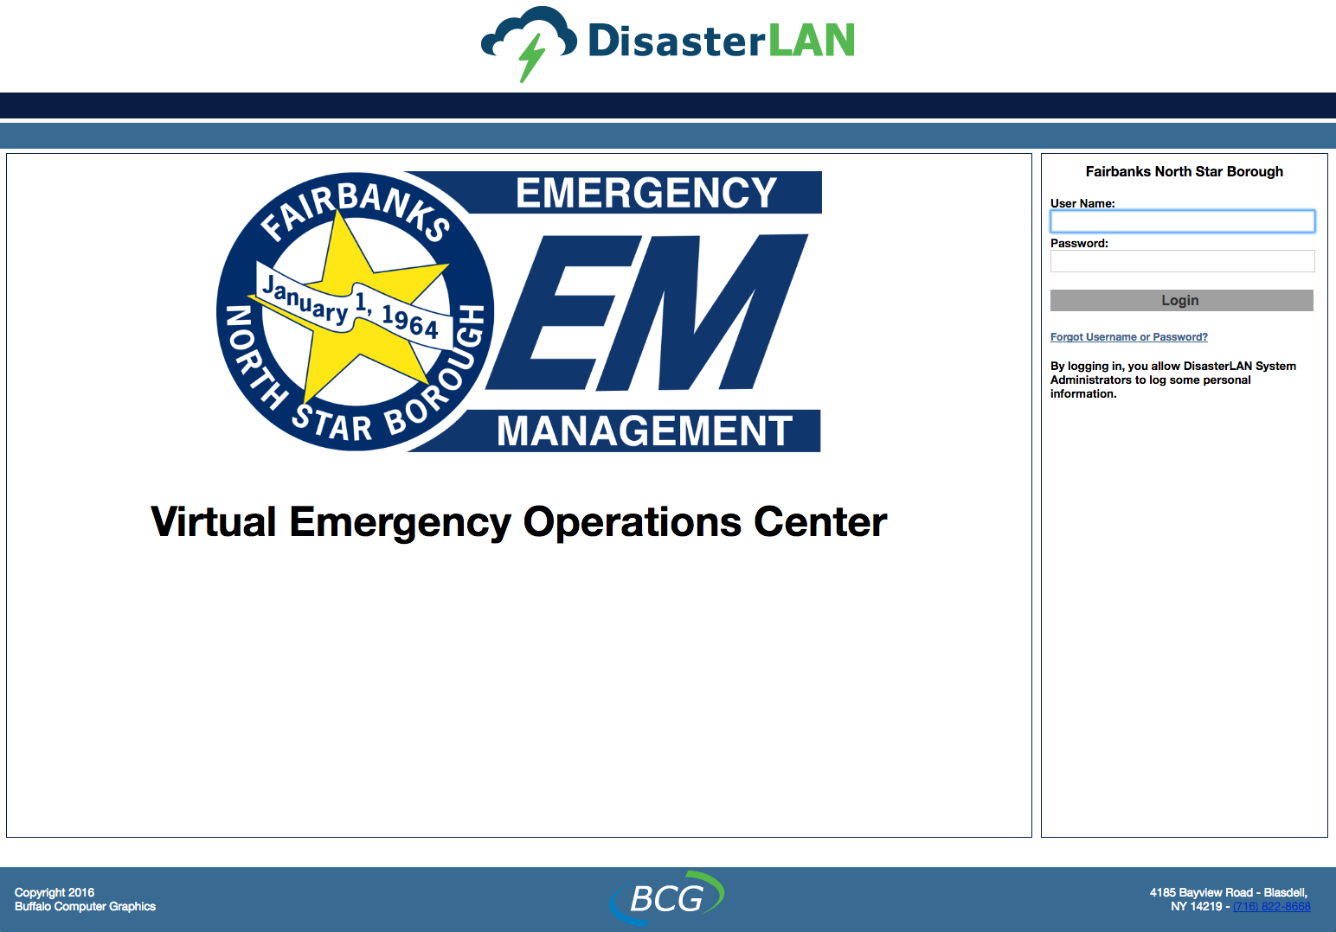
Use Case: Emergency Management
Operation Landing Page

Slide 37
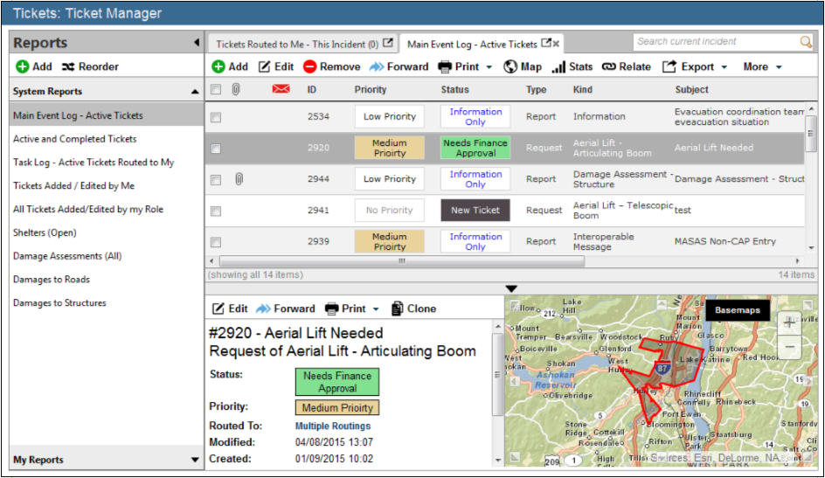
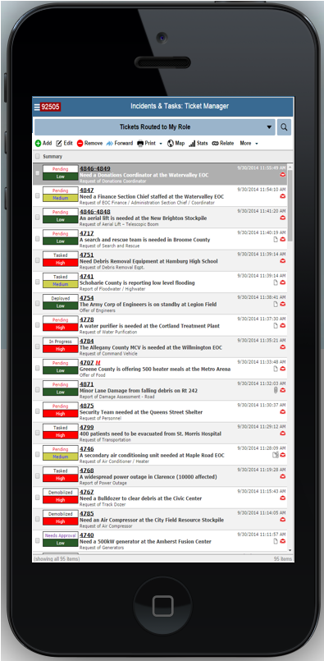
Use Case: Emergency Management
Issue Tracker

Slide 38
Use Case: Emergency Management
Daily Operations

Slide 39
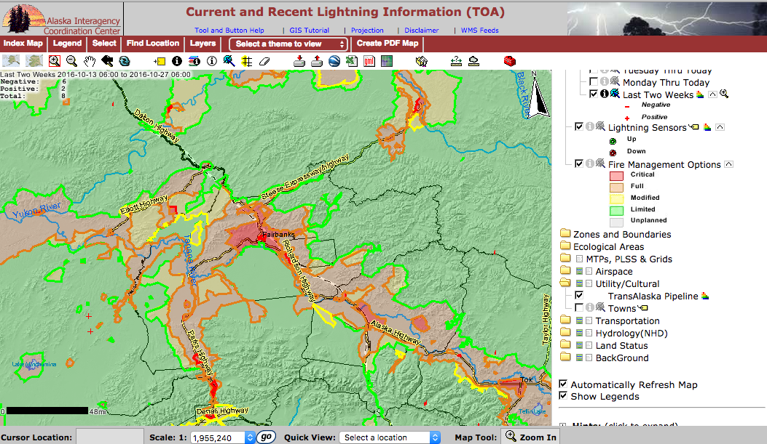
Use Case: Emergency Management
Georeferenced remote sensing data

Slide 41
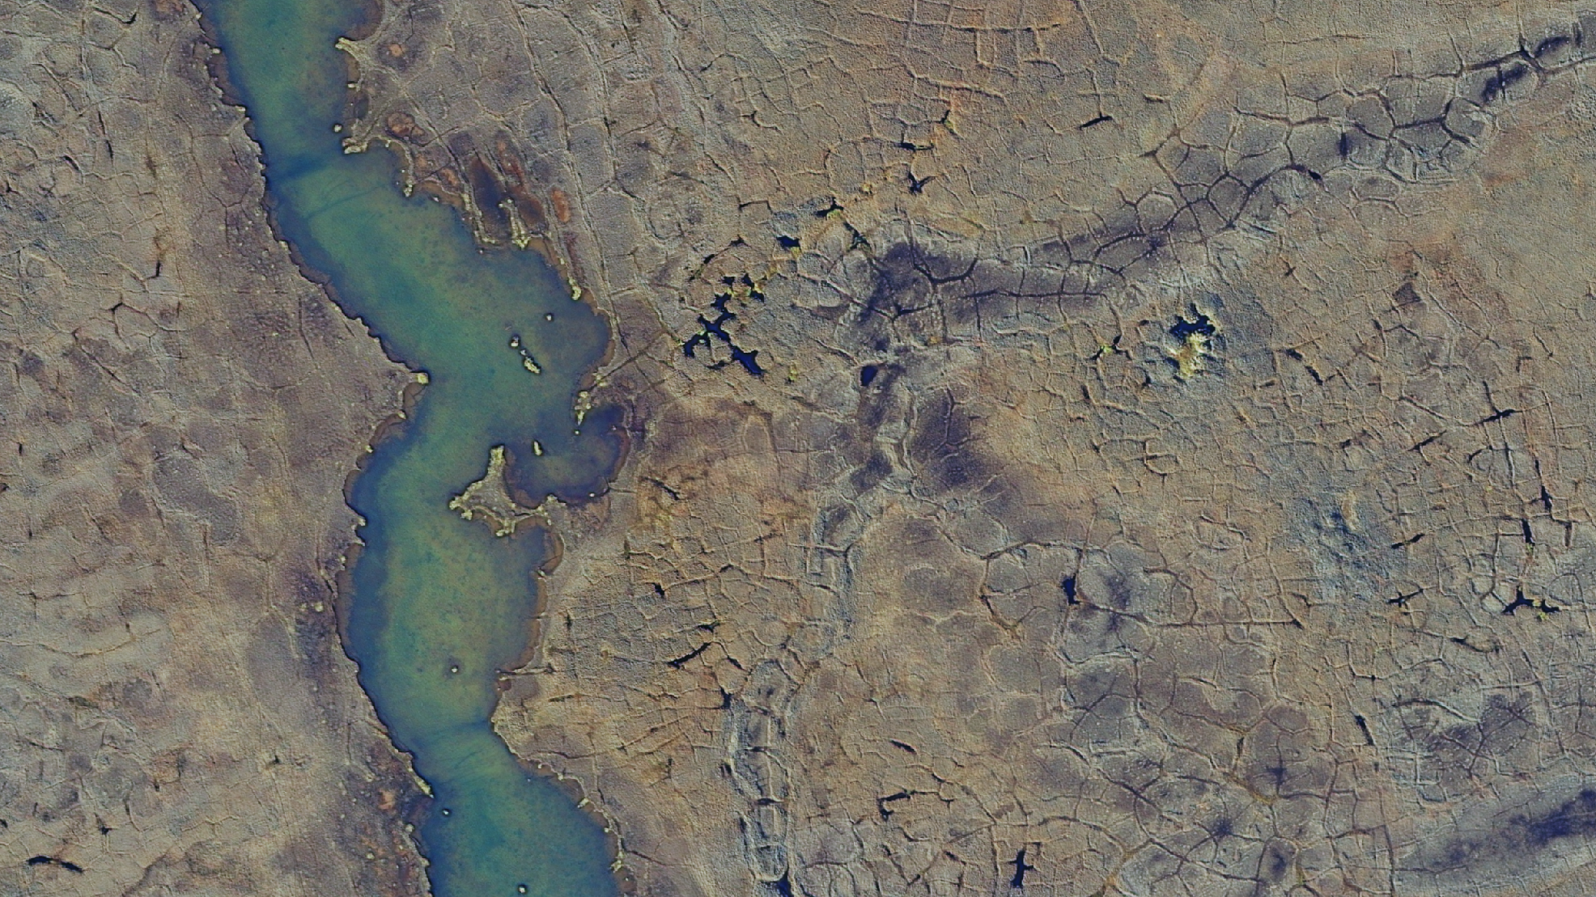
Notes:
1

Slide 42
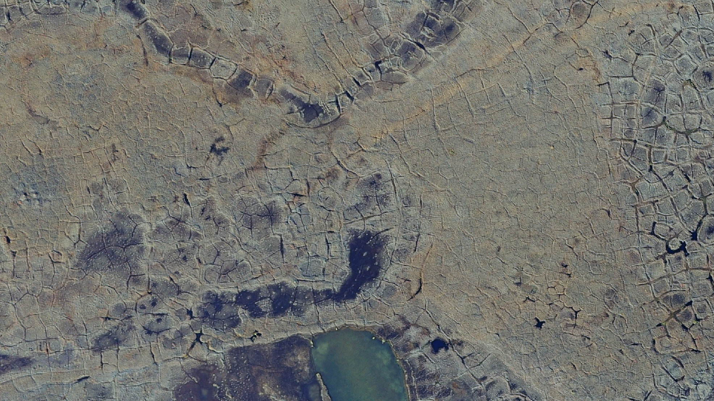
Notes:
2

Slide 43
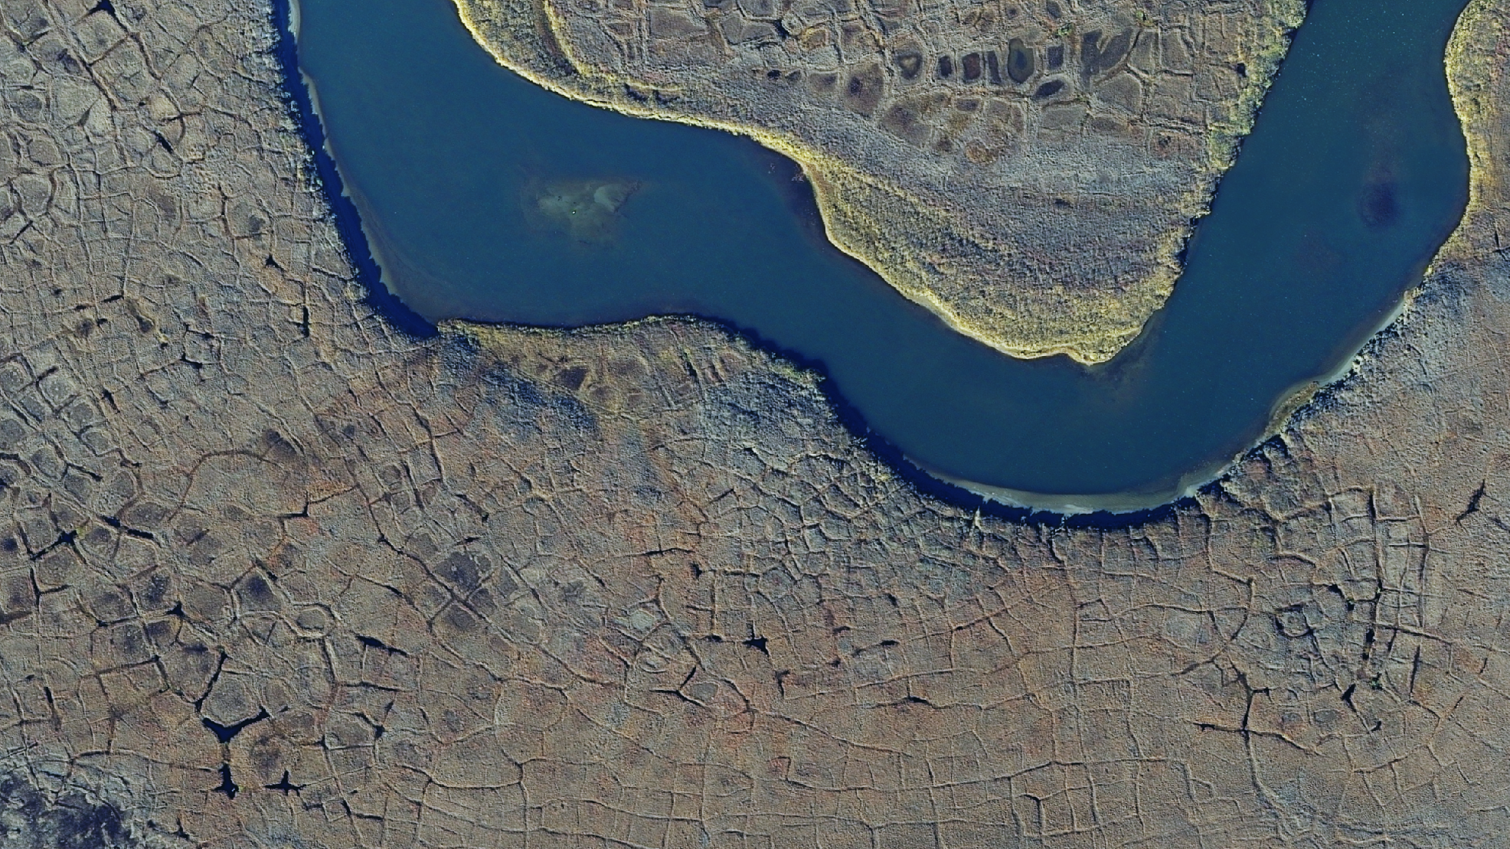
Notes:
3

Slide 44
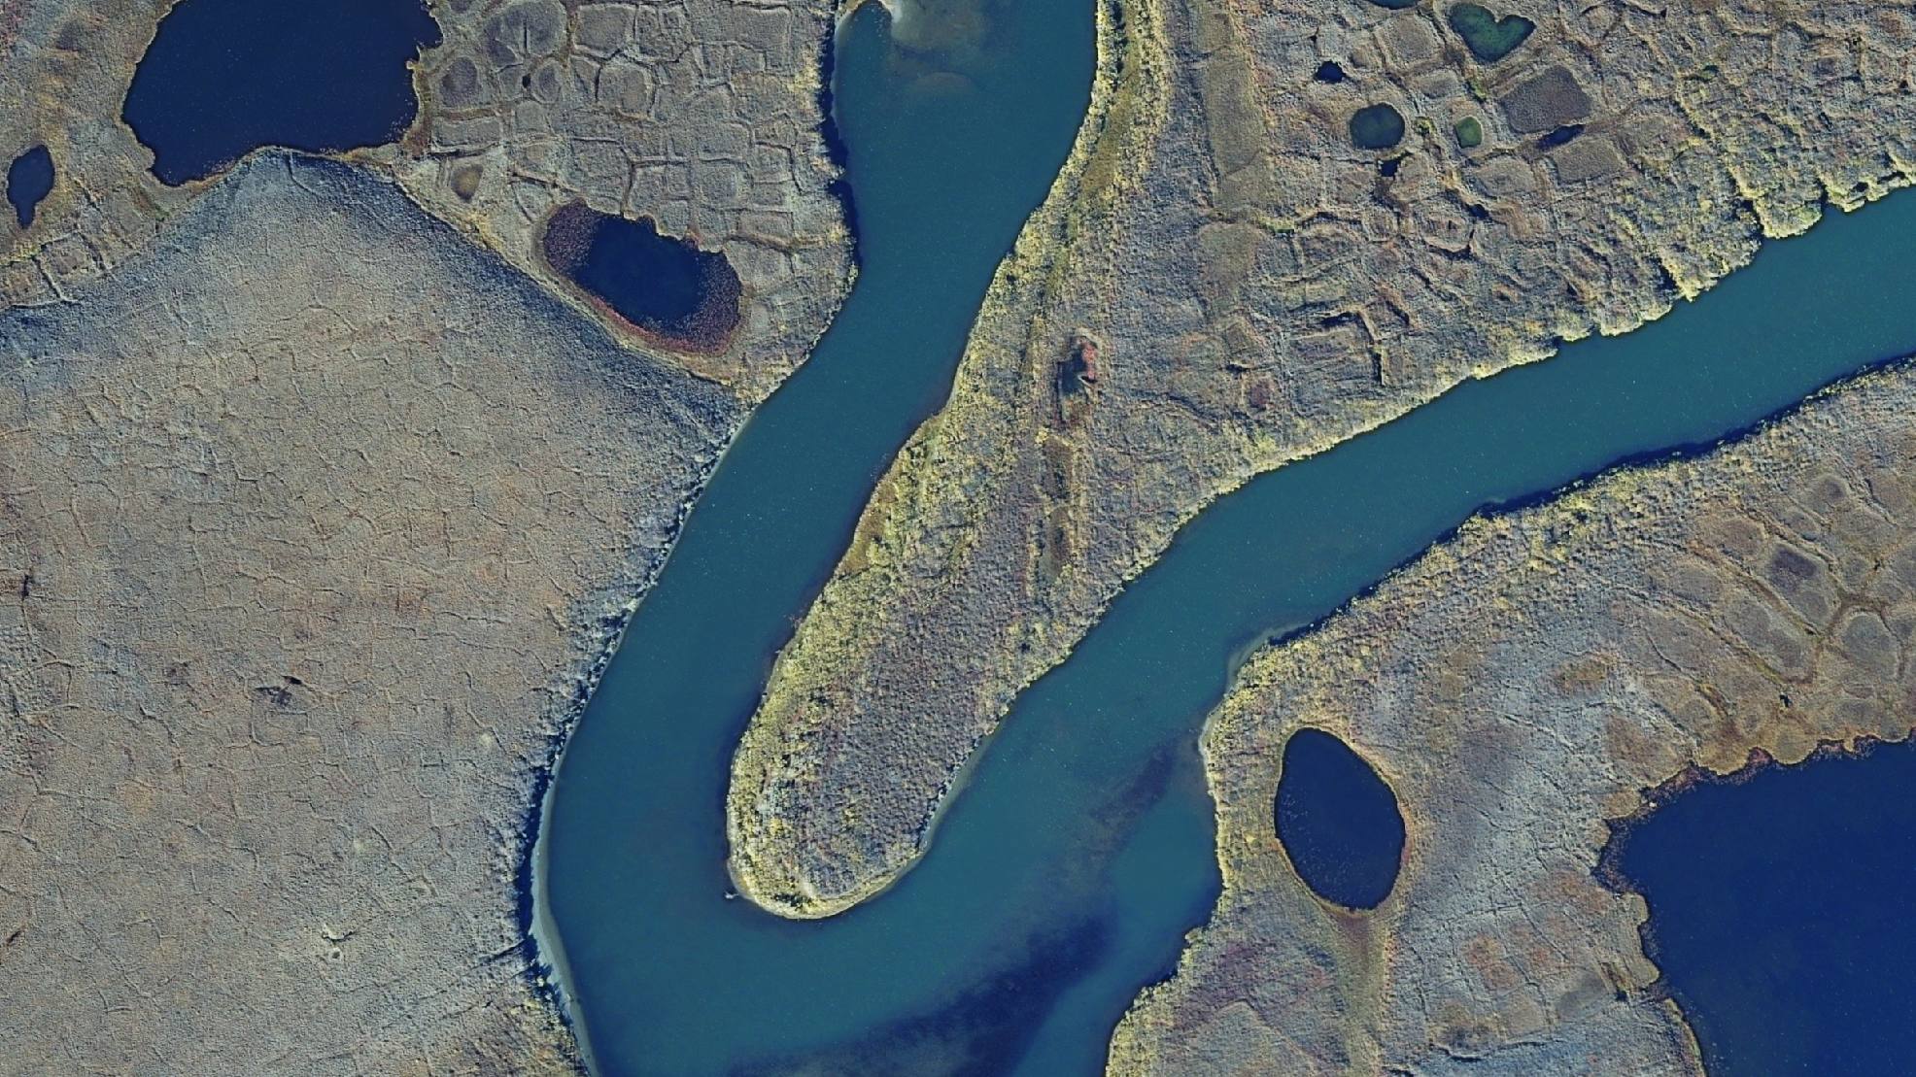
dtn.alaska.edu
contact Pips Veazey to discuss your projects
adveazey@alaska.edu
Notes:
4

Slide 45
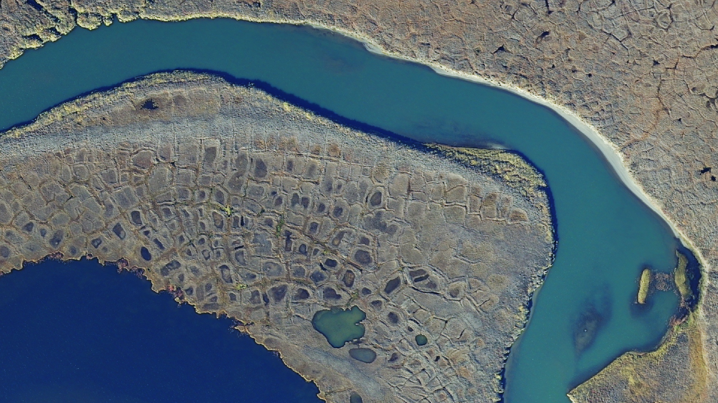
Thank you from the DTN team:
Pips Veazey, Dayne Broderson, Vanessa Raymond
Debra Kouda, Tania Clucas, Bobby Signor, Josh Guerrero
& the entire EPSCoR and GINA teams
With lots of support from:
OIT: Karl Kowalski, Artem Zhdanov, Travis Payton,
Duncan Fraser, Stephen Davis, Kelly Gitter,
Eric Jensen, Jarkko Toivanen
GINA: Oralee Nudson, Greg Wirth
Facilities Services: Karl Petterson,
Ron Ashcraft and Cygnet Construction,
Kate Incarnato and Bettisworth North Architects
Notes:
5

Slide 46
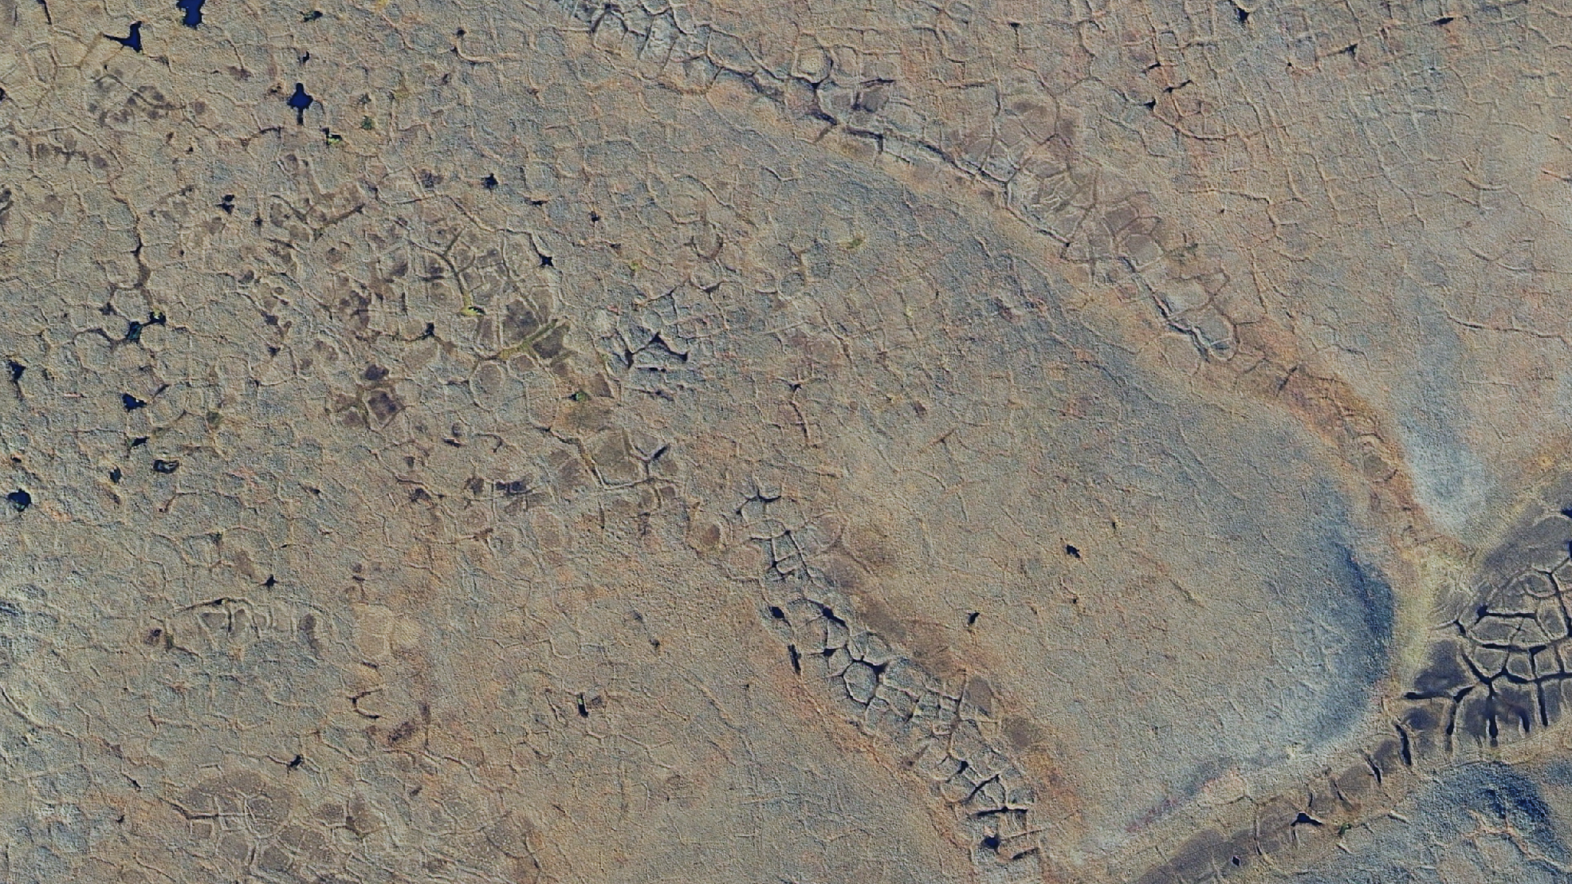
Notes:
6

Slide 47
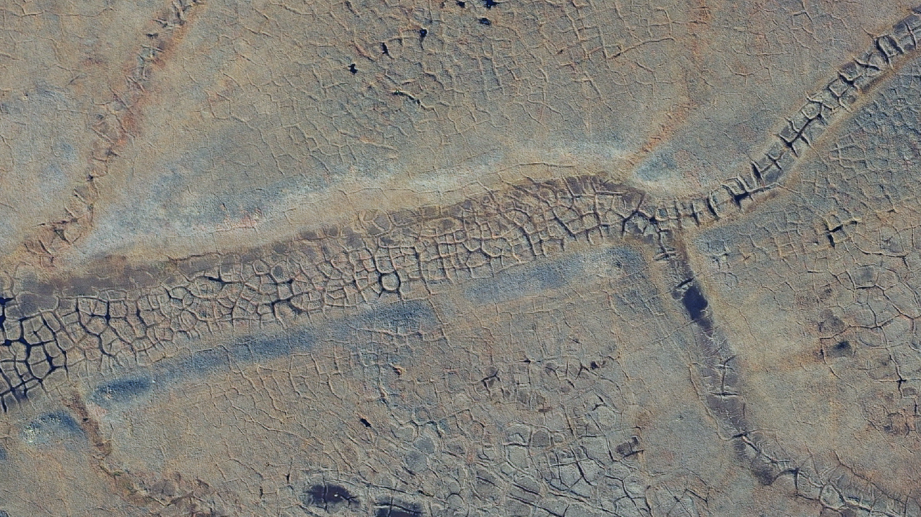
Notes:
7

Slide 49
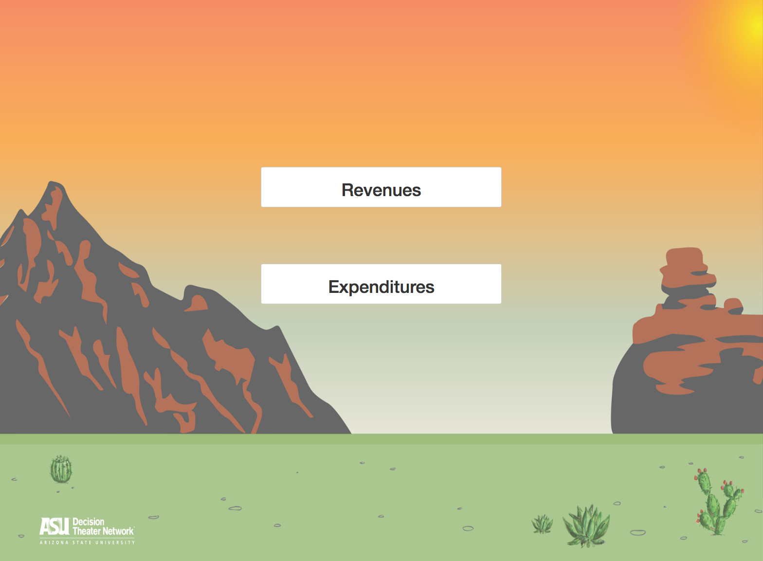
DTN Use Case: Arizona State Budget

Slide 50
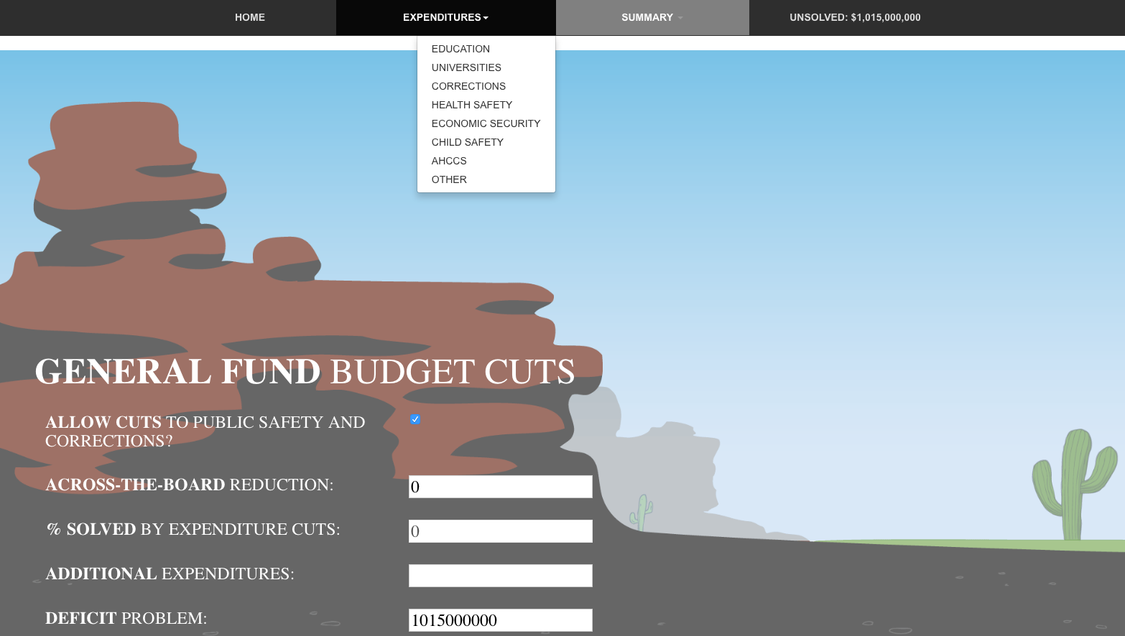

Slide 51
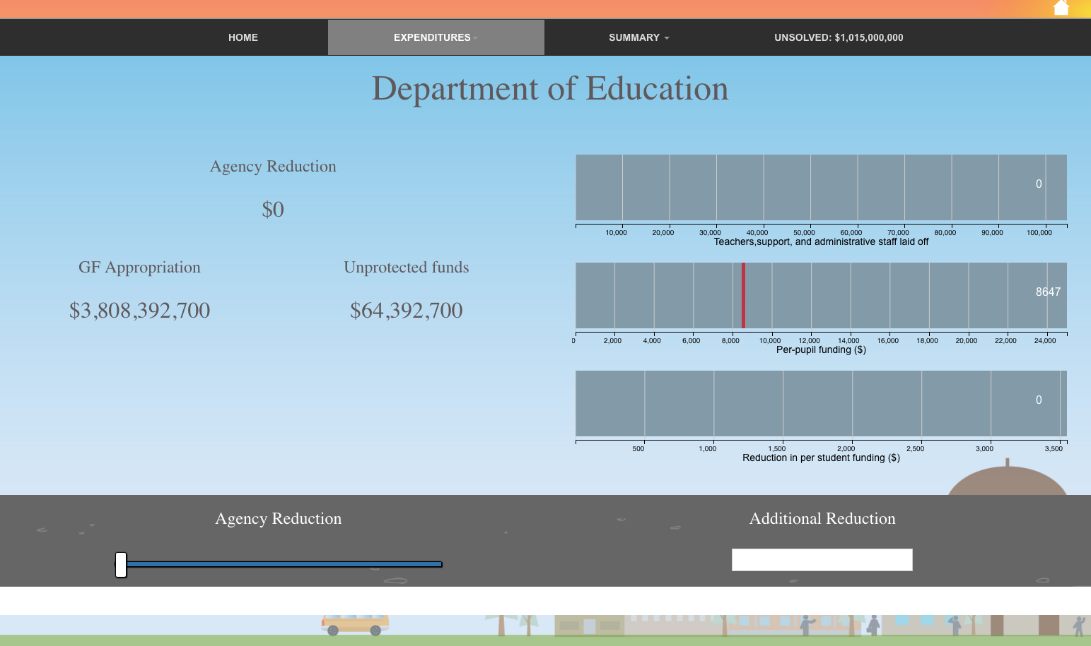

Slide 52
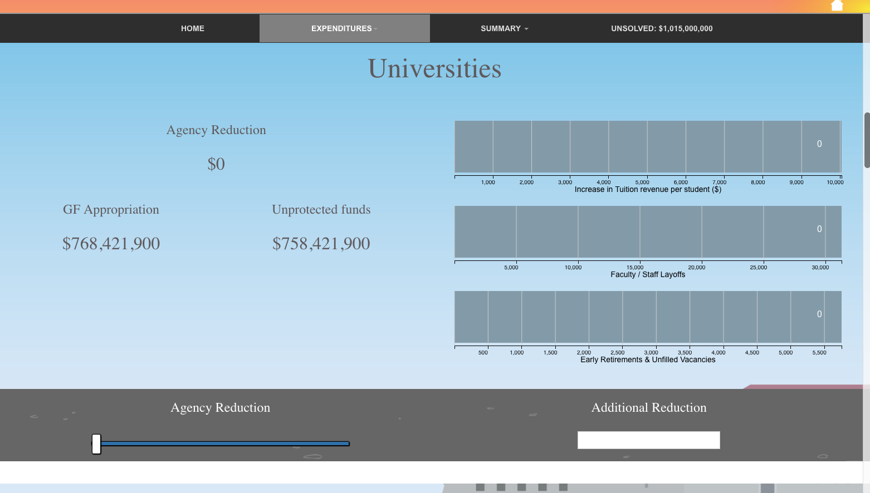

Slide 53
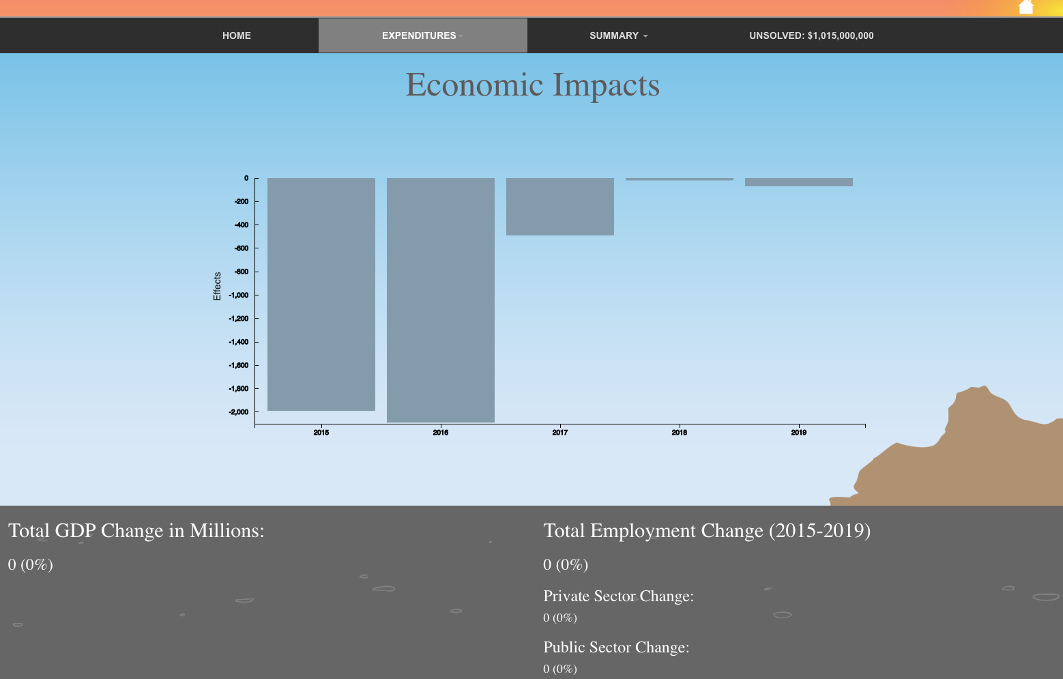

Slide 54
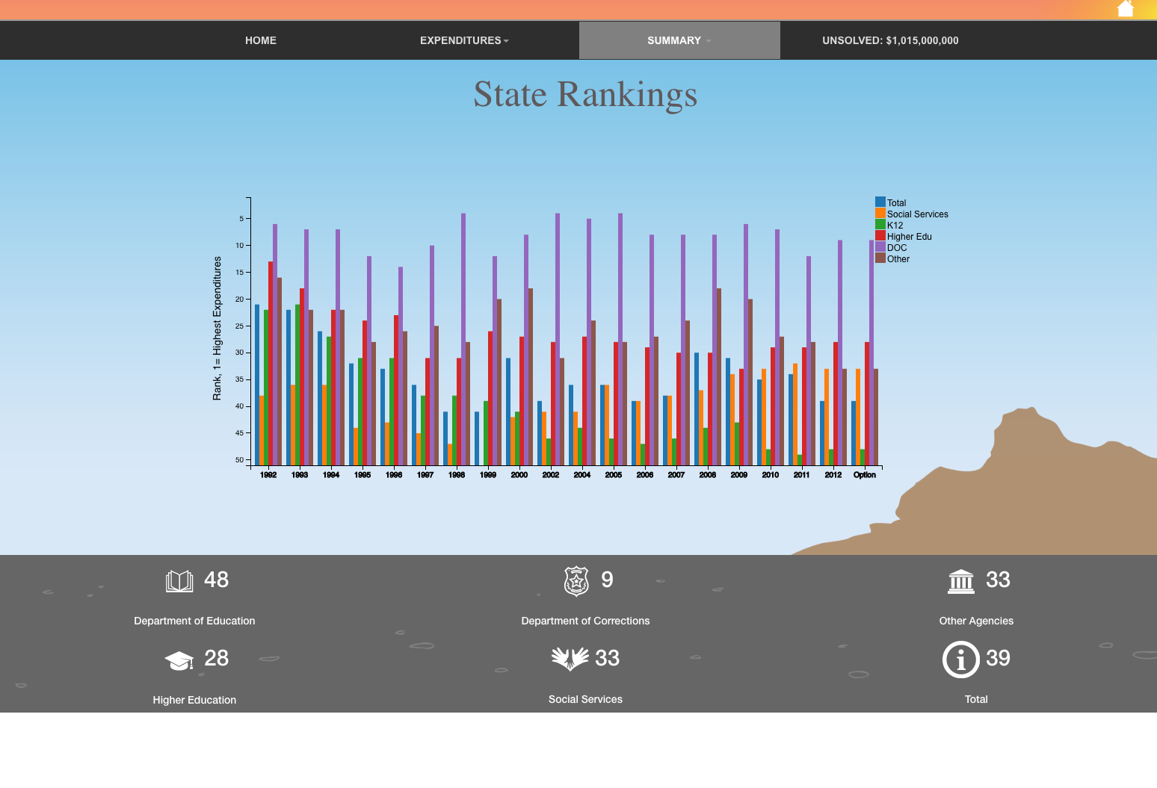

Slide 55
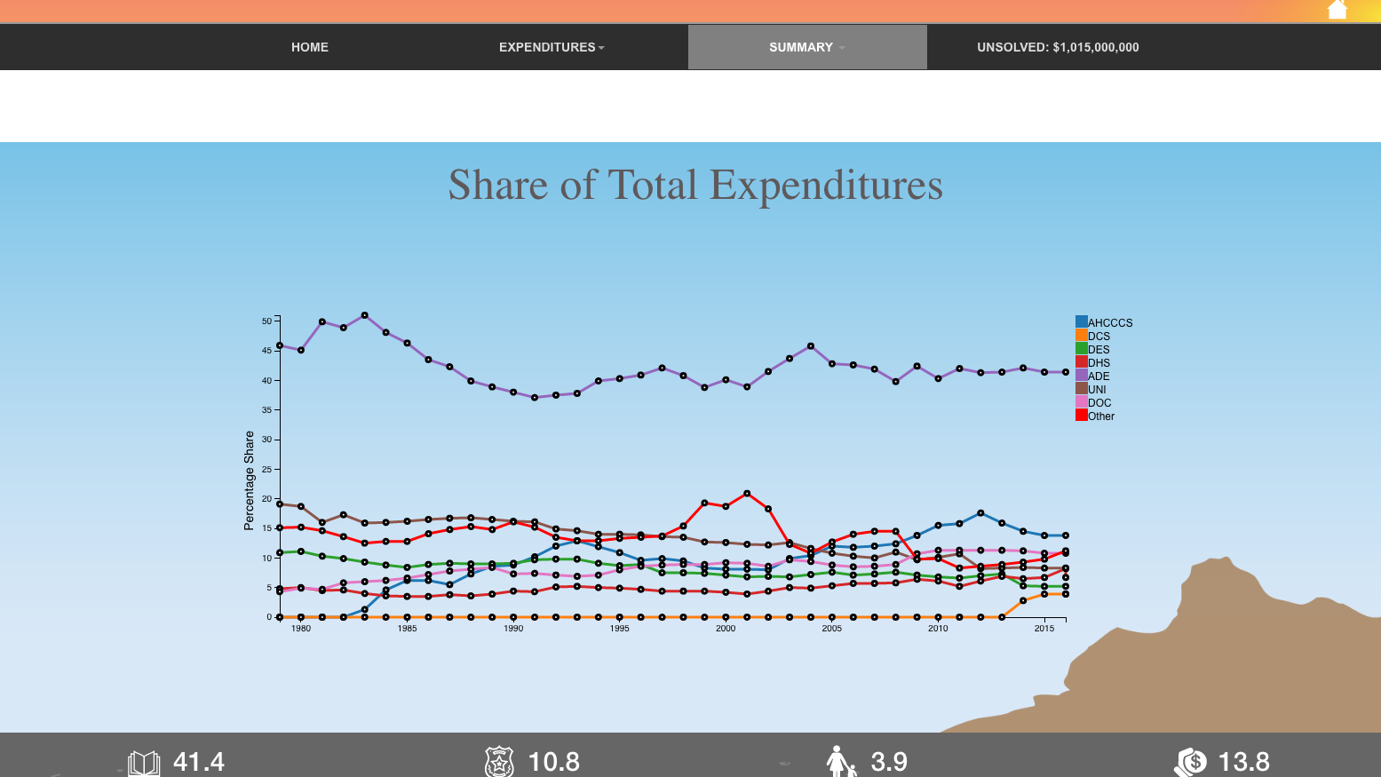

Slide 57

DTN Use Case:
Rapid development SWOT analysis
Entrepreneurship Workshop

Slide 58
Supporting document: next steps
Further develop the inventory of existing entrepreneurship ecosystem components.
Develop draft of action plan
See the EPSCoR-Alaska-Action Plan Workshop-Draft document
This action plan will be the second slide presented on day one of the workshop
Finalize Slide #2 (objective and action plan summary)
Submit action plan Friday, January 15th

Slide 59

Supporting document: SWOT analysis

Slide 60


Slide 61
Supporting document: example statements
Increase the amount of start-up companies based on university innovation
Increase communications between researchers and industry
Change university culture to one that embraces technology commercialization
Increase the number of SBIR/STTR awards to university researchers
Build an entrepreneurial culture on campus
Make it easier for researchers to engage in technology commercialization
Better integrate the business school in technology commercialization efforts
Create a mentor network for accelerating technology commercialization
Increase collaboration among major research universities in the region
Establish a university-based venture fund
Work with the state to make it easier/more attractive for starting new businesses
Establish a statewide business plan competition for students
Establish a university technology-based business plan competition
Implement the business model canvas process in entrepreneurial education programs
Engage outside business experts in the invention disclosure/assessment process

Slide 62

Supporting document: summary statement

Slide 63



Supporting documents: references

Slide 65

Joint Land Use Study
Height Overlay
Restrict building height in flight paths around airfields
1 of 13 recommended practices for FNSB from 2006 JLUS
Defined flight angles (imaginary surfaces)

Slide 66


Slide 67

2D Example of Fort Wainwright Buildable Height

Slide 68

3D Example of Fort Wainwright Buildable Height

Slide 69

2D Example of Eielson Buildable Height

Slide 70

3D Example of Eielson Imaginary Surface

Slide 71
Margin of Accuracy for Elevation Data
DATA SET | HORIZONTAL ACCURACY | VERTICAL ACCURACY | PIXEL SIZE
2010 Corps LiDAR Elevation Data | 1.3 feet (0.4 meters) | 0.5 feet | 4 feet
2010 SDMI IFSAR Elevation Data | 40 feet (12.2 meters) | 9.8 feet (3 meters) | 5 meters
2012-2013 Pictometry Aerial Photography | 6.6 to 13.2 feet (2 to 4 meters) | n/a | 4 inch, 9 inch, 12 inch
FNSB Parcels | 0 to 100 feet (typically 10 to 30 feet) | n/a | n/a

Slide 73
JUNKYARD

Slide 74
Decision Theater Users to Date
NASA Arctic Collaborative Environment
NOAA Sandy FCDAS visit with Steve Voltz
Alaska Entrepreneurial Tech Transfer Workshop planning group
AK NSF EPSCoR Modern Blanket Toss
Arctic Collaborative Workshop TTX attendees
Arctic Science Summit Week attendees
AK Observers and Knowledge Hub Science Steering Committee
NSSI Arctic Observers Network Stakeholders Meeting
Thesis defenses
Data to Decisions Mini-grantees
Tsunami inundation and pedestrian escape routes
Communities narrating and visualizing North Slope development scenarios
Visualizing human impact on landscapes along the road system

Slide 75

Part of a Network
Arizona State University (ASU)
Decision Theater
Tempe, AZ
ASU Decision Theater
McCain Institute
Washington, D.C.

Slide 76
McCain Institute Decision Theater, May 2016

Slide 77

Food, Water, Energy Workshop September, 2016

Slide 78
Use Case: Strategic Planning
Agenda Legislation Budget Collaborative Map Community News
Document Testimony Article

Slide 79



Use Case: Presentation
Explanations & Summaries
Charts
Charts
Goals & Objectives
Movie
Successes
Photo

